Slide 1
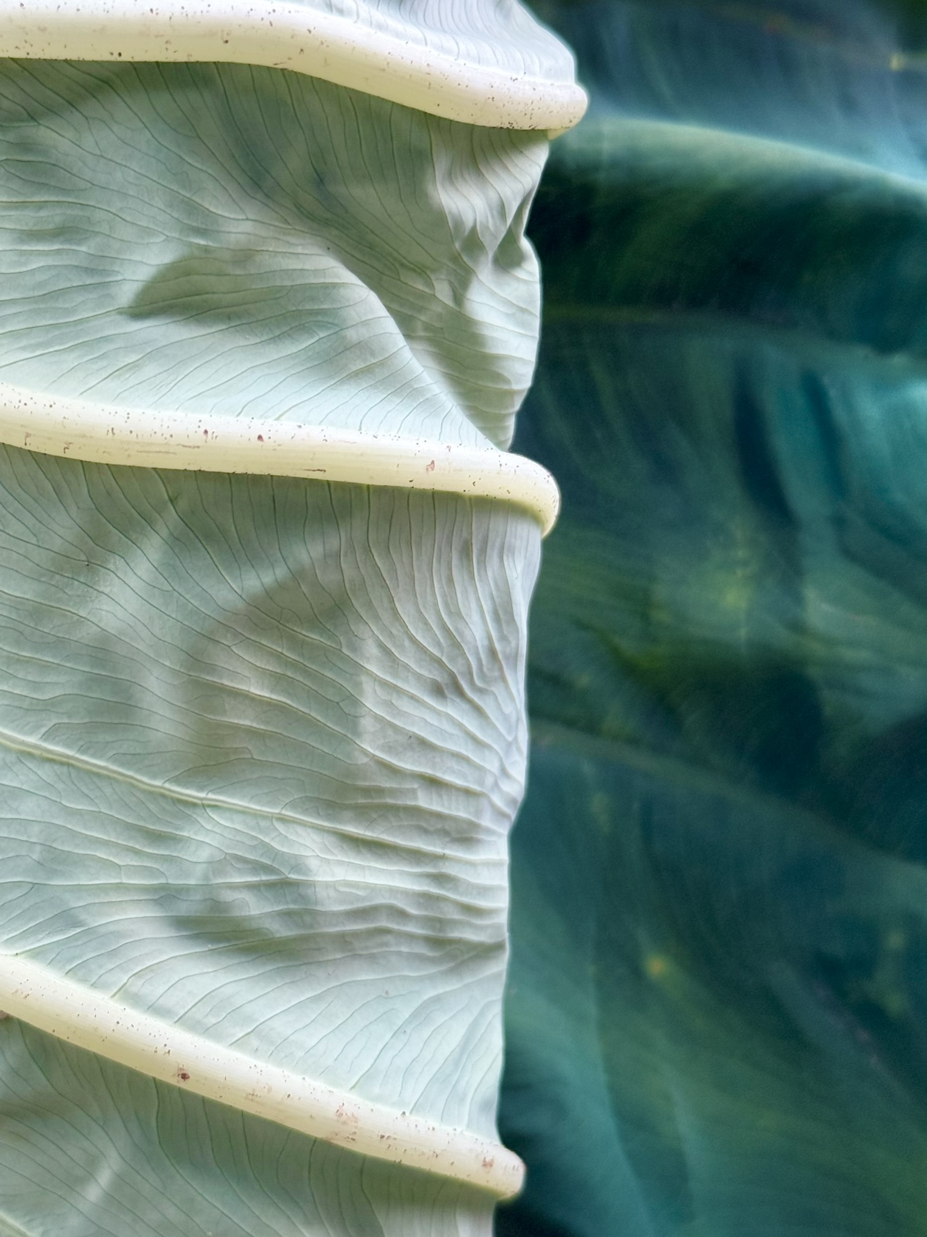
Love Letters to Nature:
Healing through
Nature Photography and Abstract Painting
MARY BETH ELY
Photography and Abstract Painting
Notes:
Happy and excited to be here tonight – have had such fun taking photos out in Nature, and, more recently, making abstract paintings – and I am excited to share my work with you who have also been doing art for a long time. I look forward to hearing a bit about your own stories.
The fun has been real – and at the same time, making the photos and paintings has been very meaningful for me in ways that I didn’t initially expect. There have been hard times in the last few years (don’t we all have hard times!?!) and making the art has provided both a respite or refuge and a means of expressing difficult emotions. I found this healing.

Slide 2
PHOTOGRAPHY
Nature: Landscape, Macro, and Abstract
Notes:
Before I share some of my work with you, I want to provide some context.
* Retired psychologist – worked as therapist for children and families for more than twenty years, then moved to teaching and training counselors and psychologists
* In the last ten years of teaching, I studied connections between nature and human-well-being – looking at how time in nature improved well-being, and how environmental damage, including climate change, hurt not only the natural environment but we humans.
I became more attentive to the natural world, more protective through environmental activism, more grateful in general. And I came to believe what ecologist and theologian Thomas Berry said:
"Our relationship with the earth involves something more than pragmatic use, academic understanding, or aesthetic appreciation. A truly human intimacy with the earth and with the entire natural world is needed.”
And as actor Harrison Ford said a few days ago in a commencement address at Arizona State University:
“Nature doesn’t need people. People need nature to survive…. Humanity is a part of nature, not above it. … The trees, the mountain, water, soil are not commodities. They are relatives to be cherished for following generations to embrace and protect.”
Nature is the main character here.

Slide 3
"The camera is an instrument that teaches people how to see without a camera."
~ Dorothea Lange
Notes:
First, a few words about how I practice photography.
What cameras do I use? Whatever I have with me! DSLR cameras with interchangeable images, a point-and-shoot camera, an underwater camera, and, more often than not, my iPhone.
How do I edit my photos? I have tried Photoshop – totally overwhelmed! So I do minor editing – cropping, exposure correction, sometimes deepening color on my apple photo app. Once in awhile I play with multiple exposures. That’s it.
I had taken pictures for a long time – primarily in a literal documentary sense, recording who, what, where – to remember people, places, and events and to share these memories with others. As I will be showing you, that started to change for me.
A friend suggested that my “picture-taking” makes it so I am not really experiencing what is in front of me, it keeps me detached and uninvolved. I experience this in exactly the opposite way – it keeps me deeply involved and focused and appreciative.

Slide 4
HARD TIMES
* Covid pandemic
* Loss
* Aging in general
* Political and social chaos and upheaval
Notes:
So when hard times began to come – boom boom boom – as they often do in life, I found myself seeking refuge in nature.
What were my hard times? Most are not particular to me – I suspect that many of us can identify with several of these.
*The pandemic
*Loss
*Aging in general
*Political and social chaos and upheaval

Slide 5
pay attention with love…
Notes:
When the pandemic hit, I started to spend a lot of time outdoors as a time and space for refuge, beginning with the pandemic – you remember all that we felt then? Isolation, fear, sadness, anger. My walks in South Park, North Park, the Botanic Gardens, and my home away from home, Mingo Creek Park provided respite. Photographing nature began to move me into a new space of healing and even of seeing the world.
Something began to shift as I kept going out to take photos during the pandemic. Although it wasn’t conscious at the time, the work began to morph beyond literal documentation into an art practice. Almost every day, I would go out, and different scenes and subjects seemed to draw me in, call me to see them. Charles Needle, a photographer with whom I have taken some online classes, talks about photography being a “subtractive” form of art – in taking a picture, you are removing everything from your mind, your vision, except the small scene in front of you – the scene or subject that receives your more careful attention and appreciation – the process was meditative, contemplative.
This is when my photography moved beyond documentation and recording into a form of artistic expression. The emotions that I felt as I was taking the pictures – when I was really in the flow or zone – were awe and wonder and love.

Slide 6
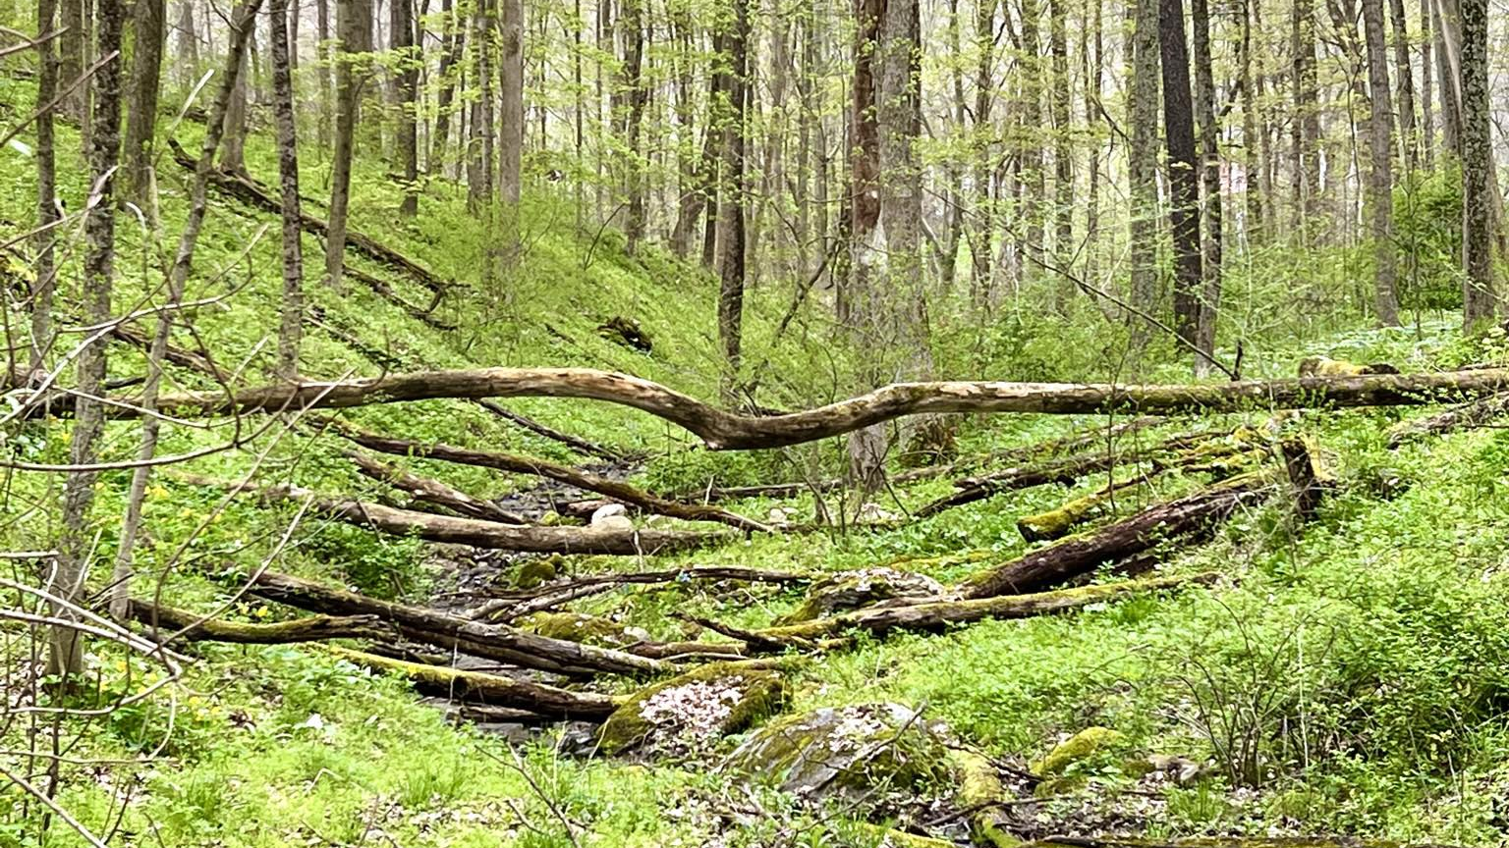
Notes:
Outdoors I felt safe. I could BREATHE without fear of becoming ill and dying.
While my photography genres overlap, early on landscapes were the predominant theme.
Landscapes – wide expansive views, the big picture – a collective or community much bigger than me, inviting, calling to me …. Like this scene in Mingo Creek.
Scenes/places like this “right-size” me, help me see myself in the context of the larger world or universe, remind me of my tiny place in the overall scheme of things where life goes on whether or not I – or other humans – are even around.
This was a perfect antidote to all of the emotions coming up during the pandemic.

Slide 7
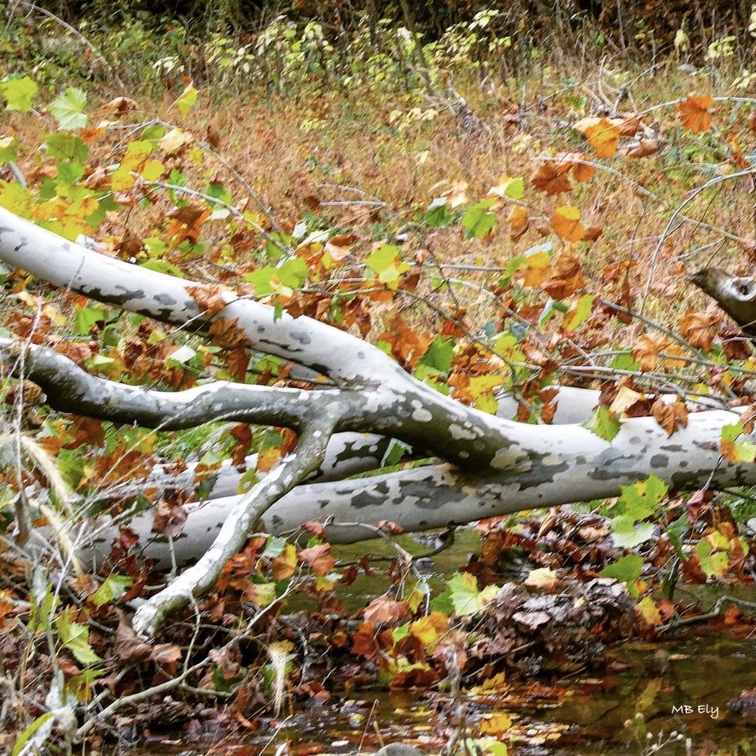
Notes:
Fall. This was also in Mingo Creek. I have not been drawn to what might be seen as classically pretty and perfect. When I worked with graduate students and therapy clients – the reality was that EVERY PERSON – the student, the client, me – was in process in their lives. Imperfect. Raw in some places. Developing. I love to capture scenes that show not conventional beauty but a vibrant messiness, an “in the middle of life” vibe.

Slide 8
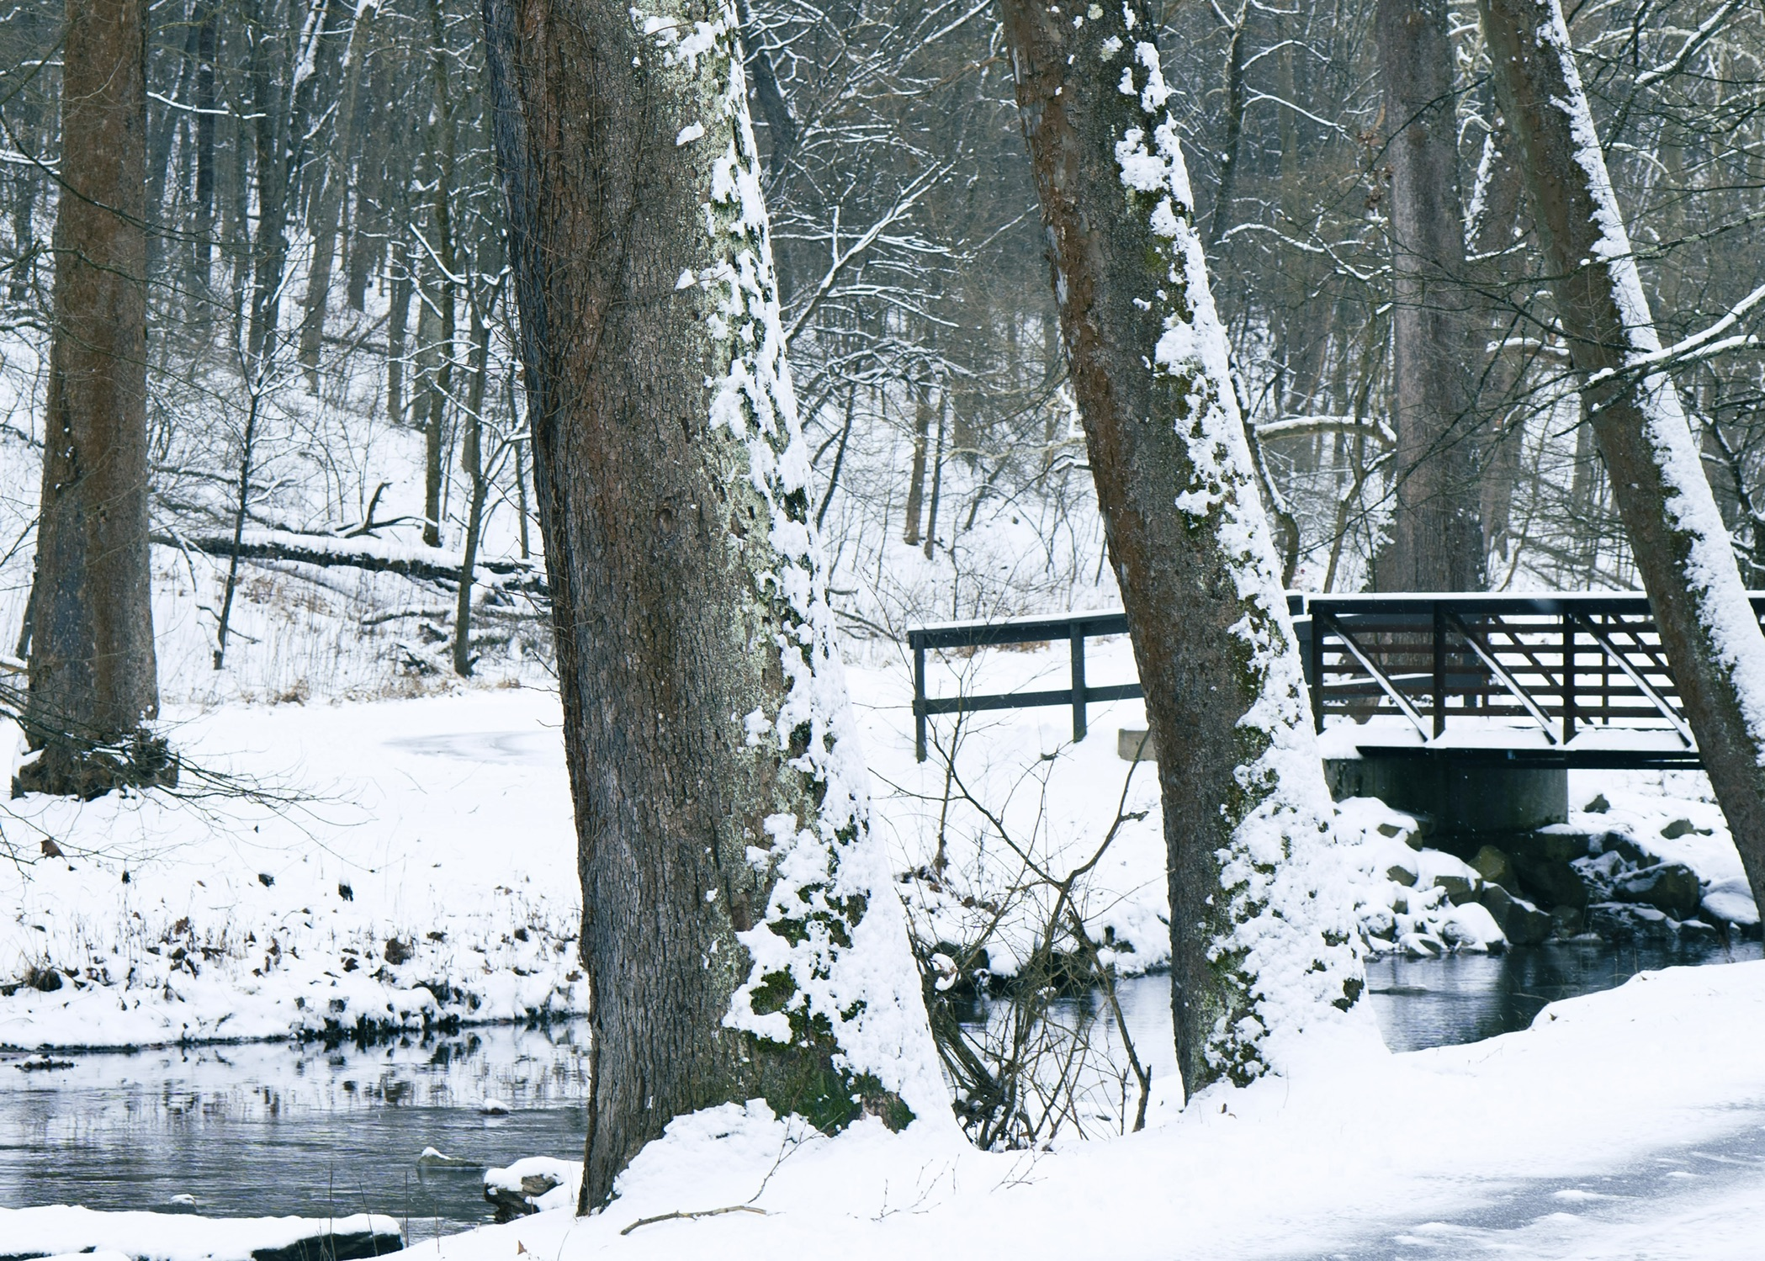
Notes:
I have taken this photo in every season. I call the three trees in the foreground “the three sisters.”
Often when I go out in the winter, I start out thinking, “Meh. Nothing here but black and white and gray. Boring.” But I always find that I am wrong about that. In this photo, for example, I love the subtle colors – look closely and you can see reds and browns and blues and faint greens.

Slide 9
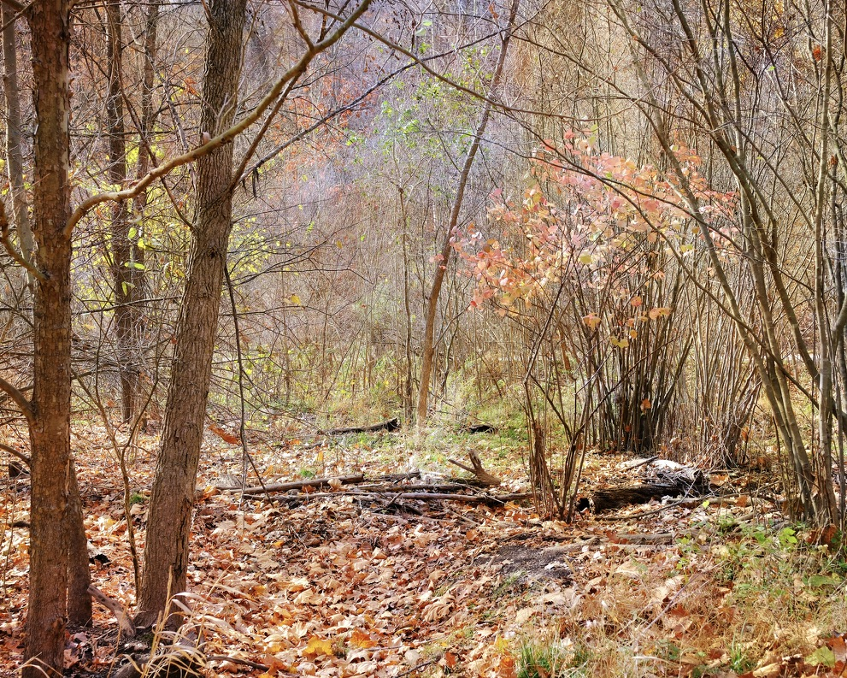
Notes:
I think Fall is my favorite season. The beauty is that you know what you are losing, and you have faith that the life will return, that life never really goes away. This was a photo that I took at Frick Park. Seemed like a fairy land.

Slide 10
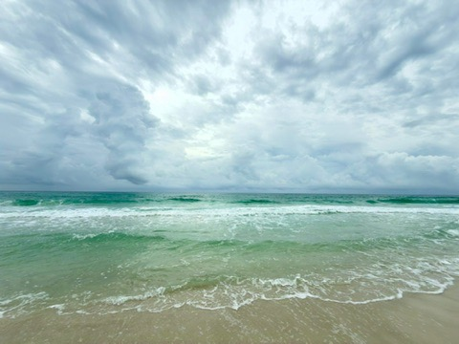
Notes:
This is NOT Mingo Creek – I have had a chance also to photograph Nature in other places in our travels. A favorite beach on the Florida Panhandle, mid afternoon – taken with my phone. I love the colors, of course, but also the energy and the expansiveness. The sky and the ocean go on and on, further than I will every see.

Slide 11
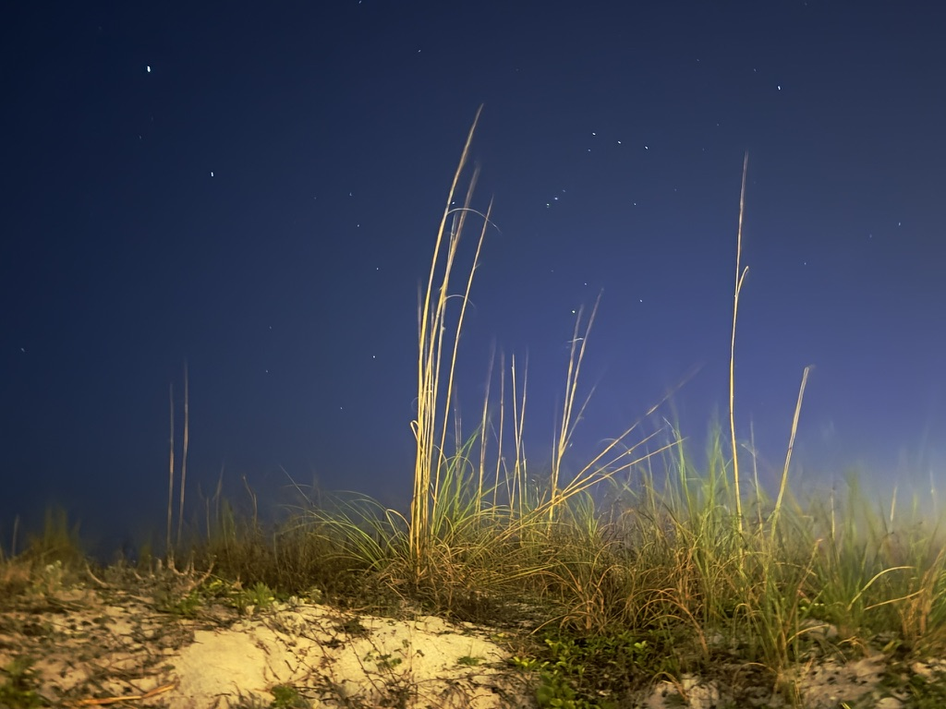
Notes:
“Starlight on the Beach” If you look very closely, you might see the big dipper. I had hoped to catch the sky full of stars, but there was too much ambient light for that to happen on that night.

Slide 12
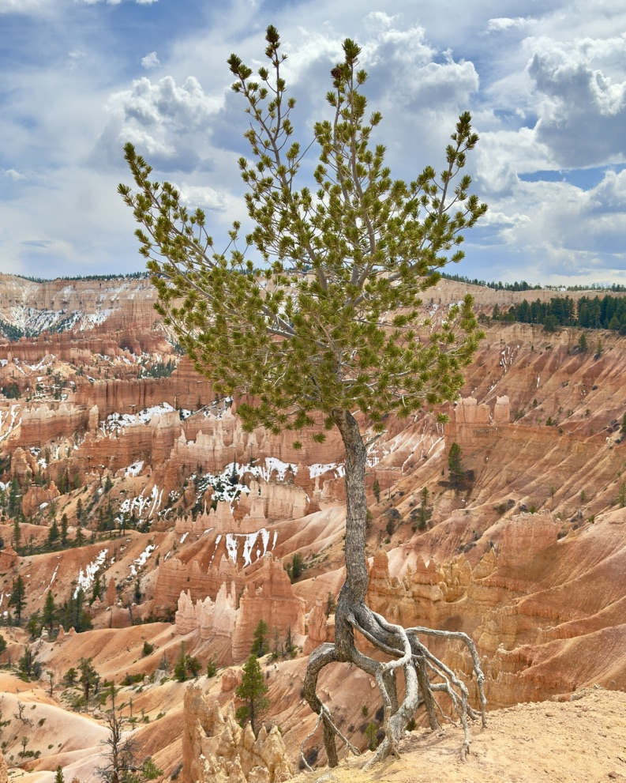
Notes:
I call this – “Hanging On (In Spite of It All).” From our 2025 road trip out to Utah - Bryce Canyon.
Again, landscape scenes serve to “right-size” me – they remind me of the larger world beyond my own little home, and even beyond humanity. The larger world, universe, goes on whether we humans are there or not. The places have been here before we humans came around, and will persist well into the future. That feels very soothing to me when so much in the today’s human sphere feels crazy and out-of-control and downright wrong.

Slide 13
go closer and deeper…
Notes:
On Christmas Eve 2020, my mother died very suddenly – not of Covid; her heart, at age 93, just stopped. My mother was an artist – she painted; she sewed and quilted and crocheted; she played the piano by ear – could hear a song once and play it perfectly. On the day she died, she was in her happy and most creative place - in the kitchen, cooking cooking cooking. She was not a talker – I always wanted to know more about her creative process. She treasured the doing more than the telling.
When she died, my photography shifted. More often, I found myself moving in much closer to what I was seeing in nature, wanting to really see the tiny aspects of the living beings that make up the larger landscapes I had been studying. I started exploring macro photography – going tiny offered me one way move through my grief. I searched for ever-present tiny life forms that cumulatively make up the larger world. Many of these were fungi, mosses, lichen, even tiny drops of water, ripples in the creek – ancient, ancient beings who have been around forever and who are living and working constantly, playing important roles in keeping life going. I was also drawn to insects and flowers and other plants – more ephemeral forms of life – life goes on.
And what I also love about the macro photography is that there is always SURPRISE! In the sense that you often see things that are unexpected.

Slide 14
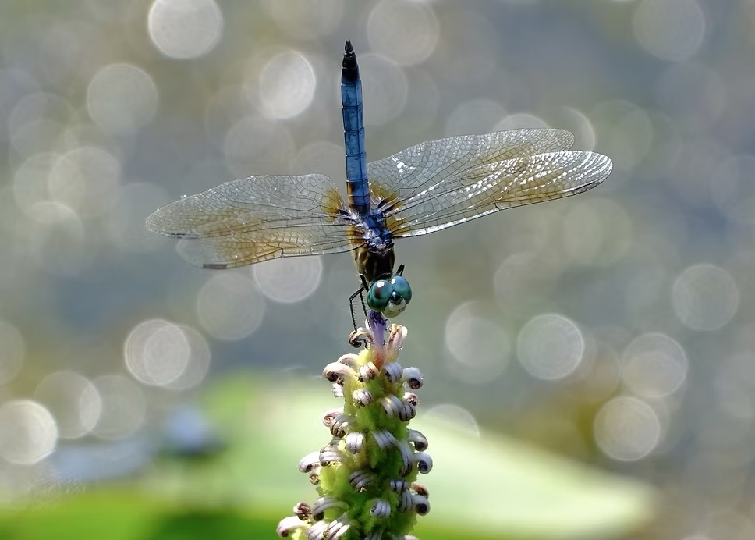
Notes:
North Park near the lake – this was such a lucky shot! It is one of my favorites. I think this is a dragon fly, vs a damsel fly. When I look into his eyes, I sense a wisdom or knowing that is nothing like what goes through our brains.

Slide 15
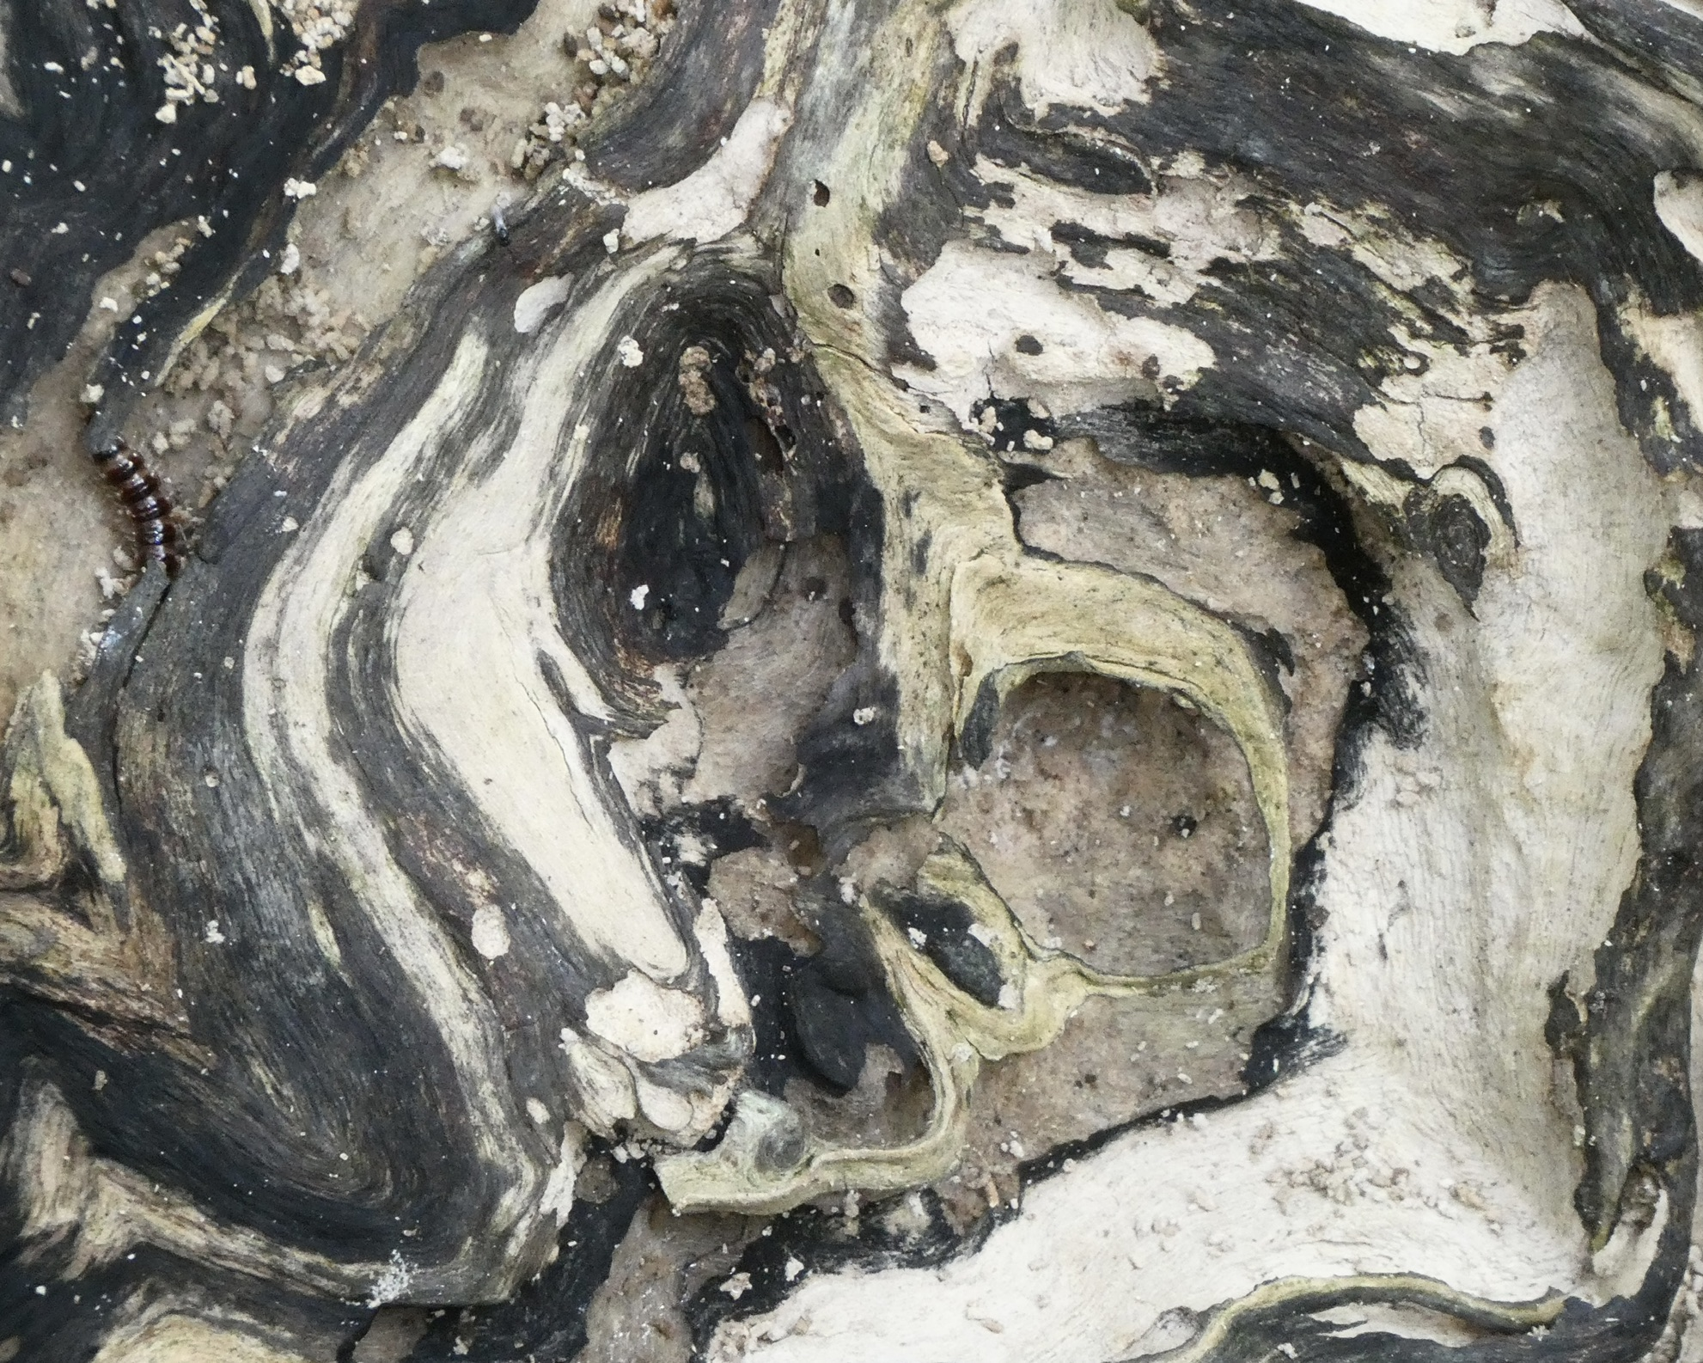
Notes:
A knot in a tree in Mingo Creek. Trees have stories to tell, in so many ways. They carry scars from all that has happened to them. I have hundreds of shots of cross sections of tree trunks, bark, knots.
This is one of those photos where I noticed an unusual thing – insect or industrial object, not sure which, in the upper left quadrant – only after I got home!

Slide 16
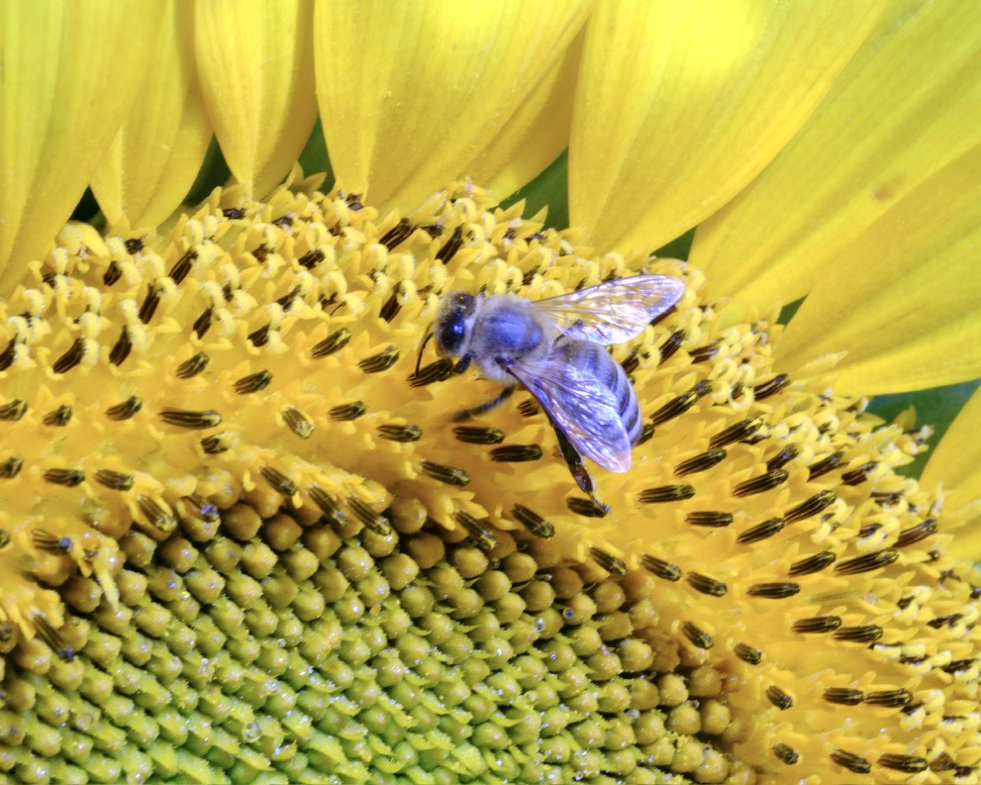
Notes:
Field trip to see the sunflowers

Slide 17
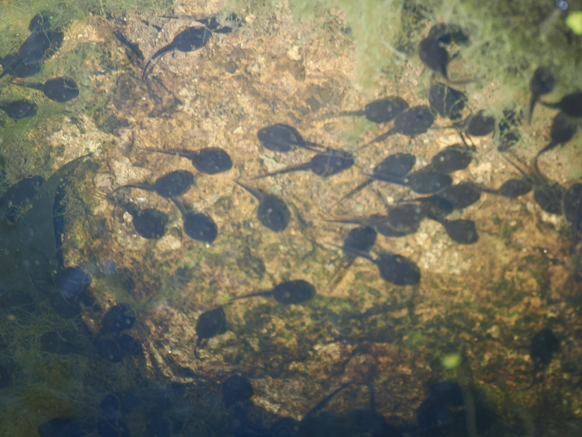
Notes:
The Pittsburgh Botanic Gardens a few days ago – tadpoles! I’m looking forward to going back in a couple of months to see and hear the frogs! They are a sight to behold.

Slide 18
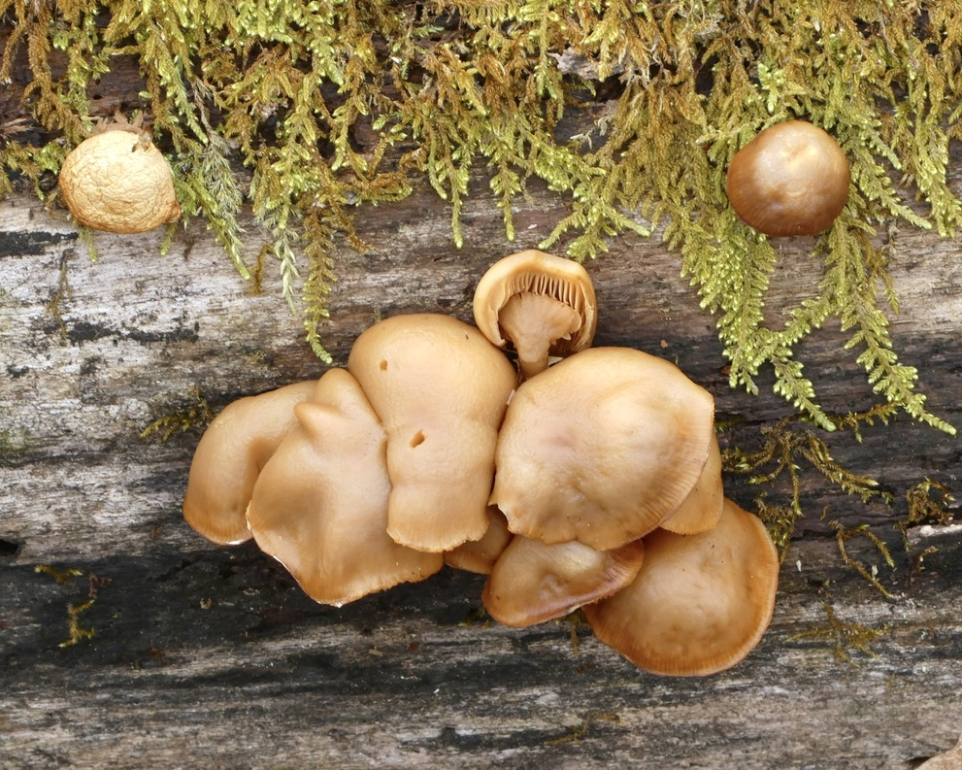
Notes:
Mingo Creek – so many mushrooms. One of my exciting days was hiking on a back trail there and coming across some bright red and white mushrooms – so surprising!

Slide 19
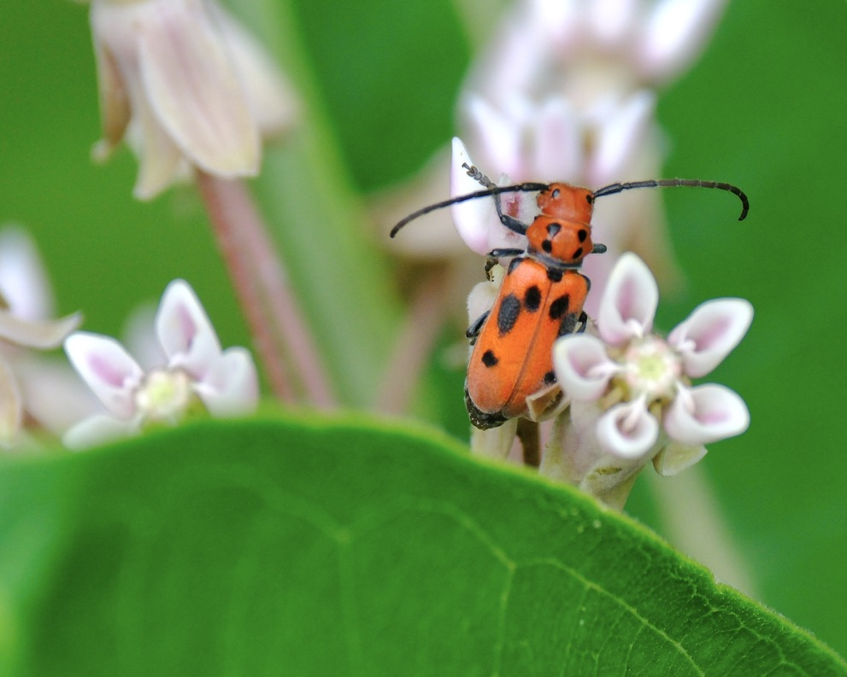
Notes:
Mingo Creek. A milkweed beetle doing his job. In high milkweed season, I see hundreds of these insects lined up along the leaves and stems and flowers of the milkweed plant.
We know that milkweed plants are vital for lives of monarch butterflies – I recently read… “Adults (the beetles) feed on the foliage and flowers of the plant, and the larvae feed on the roots. Therefore, much like the monarch butterfly, it is thought that the beetles derive some protection from predators by incorporating toxins from the plant into their bodies, thereby becoming distasteful.”

Slide 20
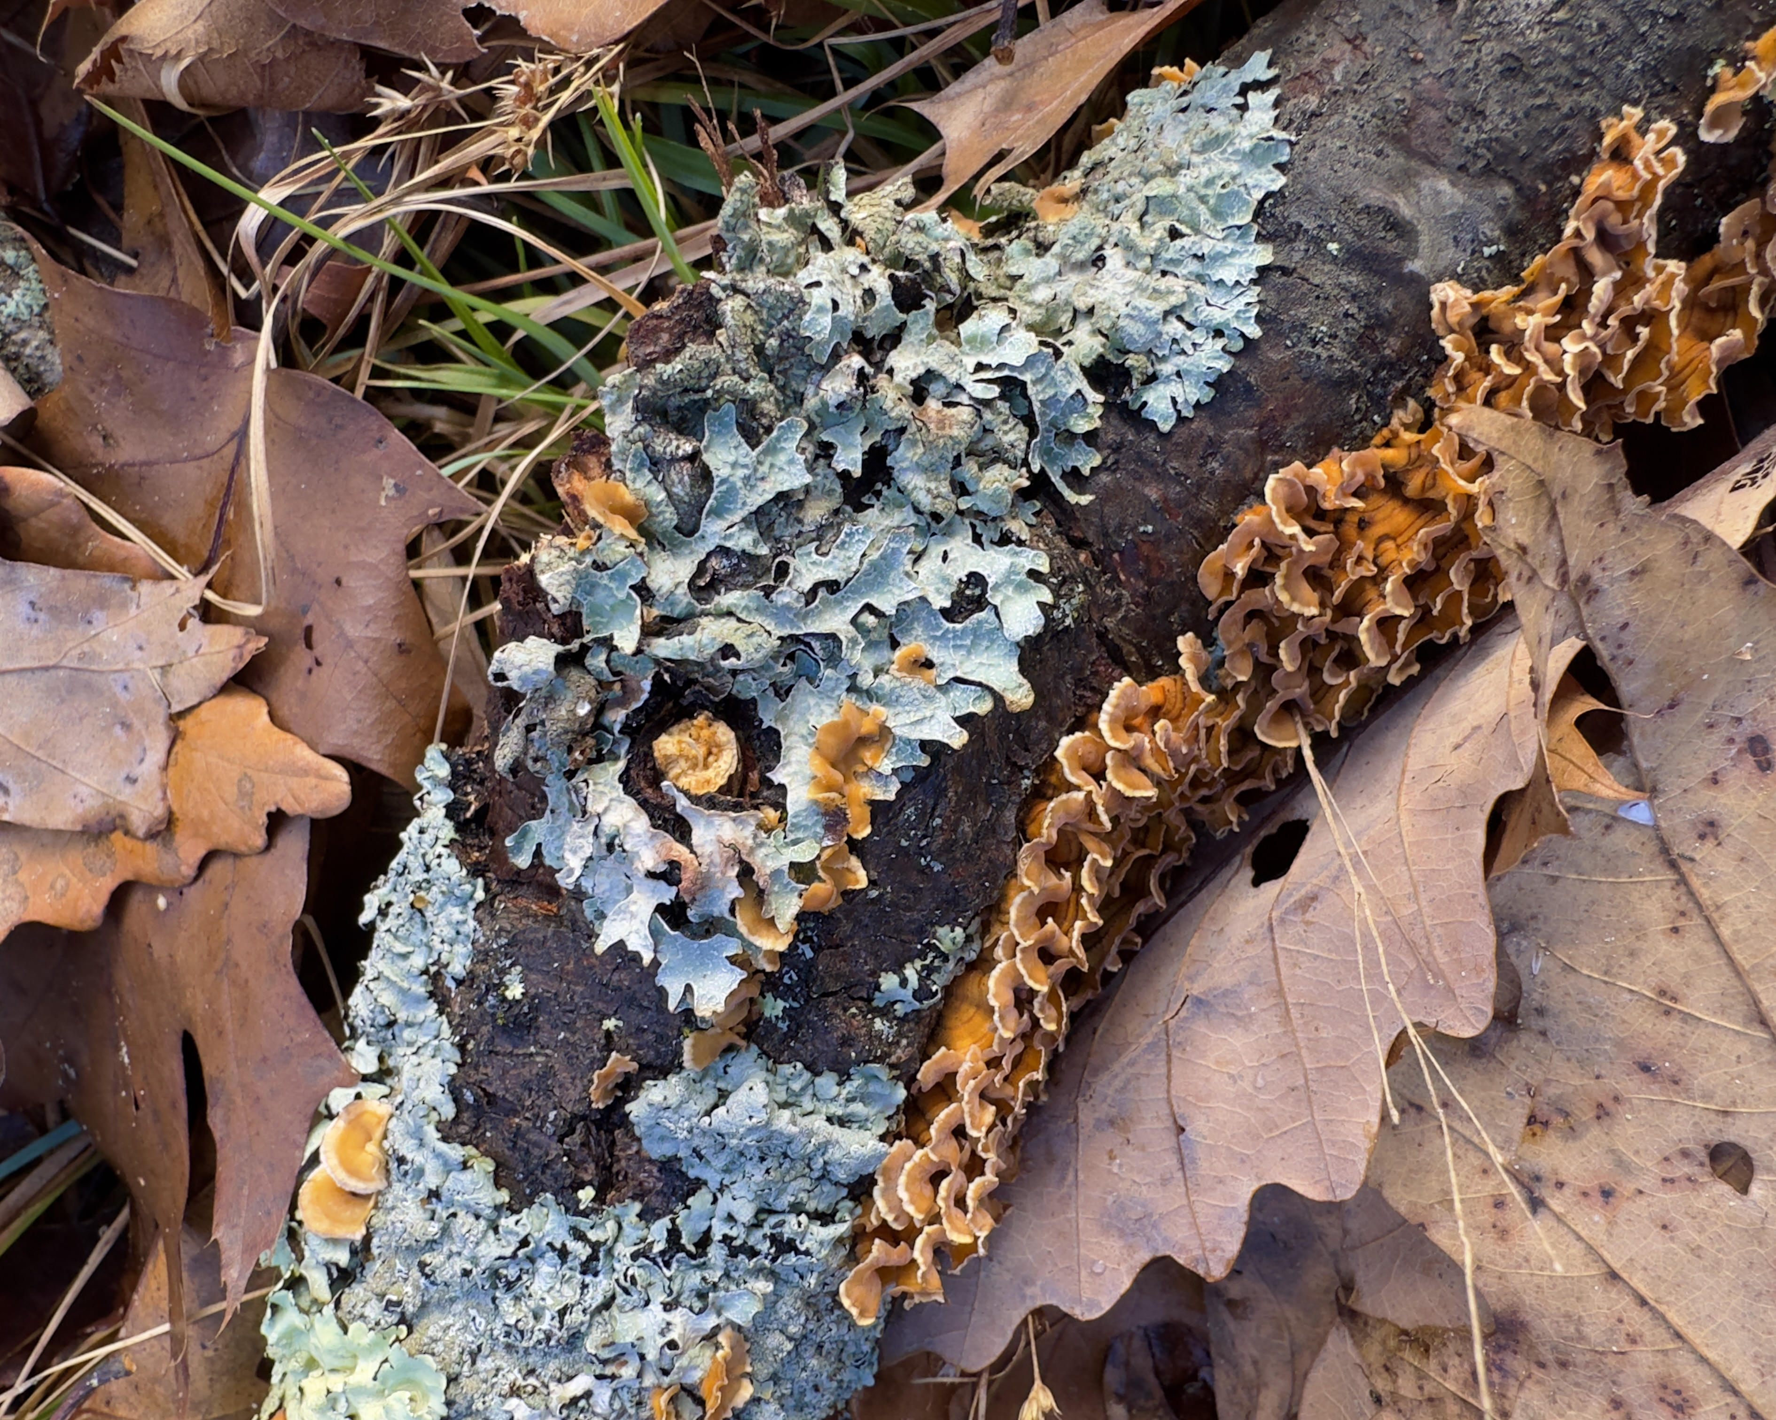
Notes:
Lichen – the cool thing about these kinds of very ancient life forms is that they are not static, they are always working, feeding and breaking things down and taking nutrients in.
“Lichen is a composite organism formed by a symbiotic relationship between fungi and algae. Evolving hundreds of millions of years ago, these hardy pioneer species broke down bare rocks into soil. This laid the chemical and physical foundation for terrestrial plant and animal life.”

Slide 21
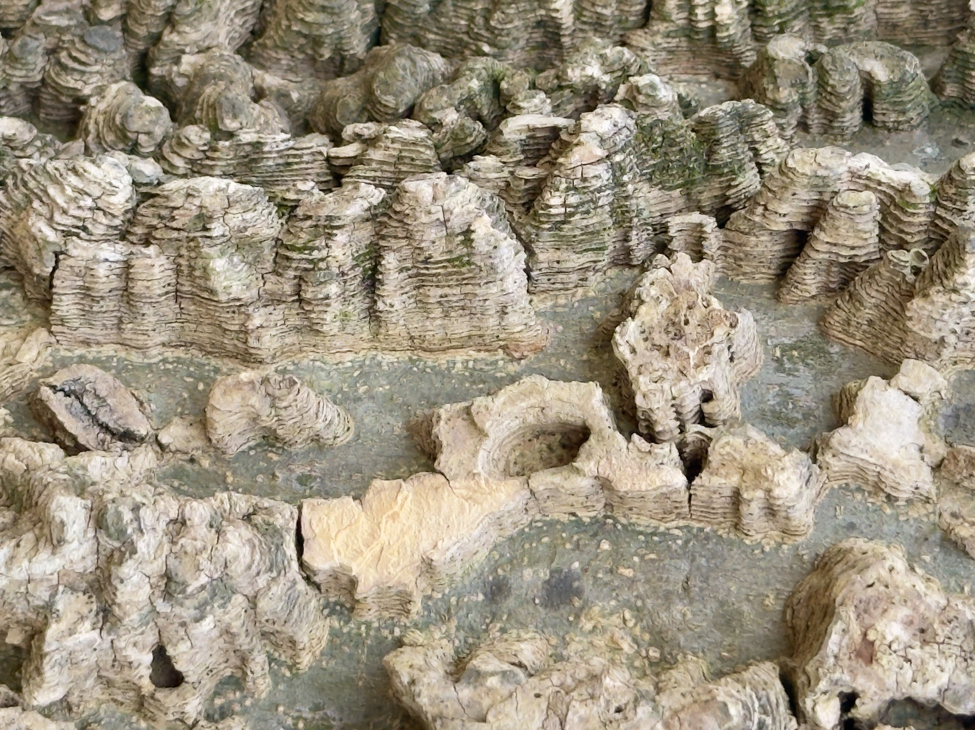
Notes:
I have hundreds of pictures of tree bark – “Tree Skin” tells so many stories about a tree’s identity and its life. This from a tree in a park in Nashville, TN. I think it is from the common hackberry tree – the texture is very cork-like.

Slide 22
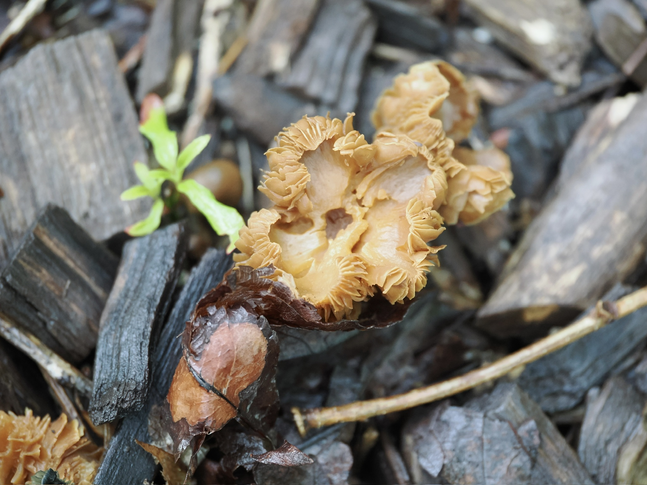
Notes:
More mushrooms.

Slide 23
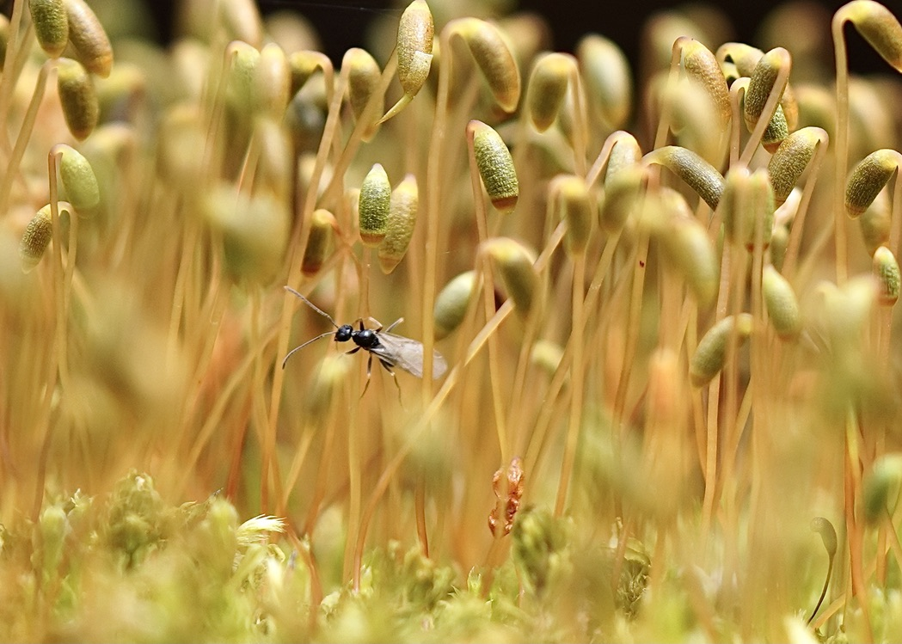
Notes:
Little moss filaments with a visitor – I didn’t even see the little guy until I got home. Classic photo-bombing!

Slide 24
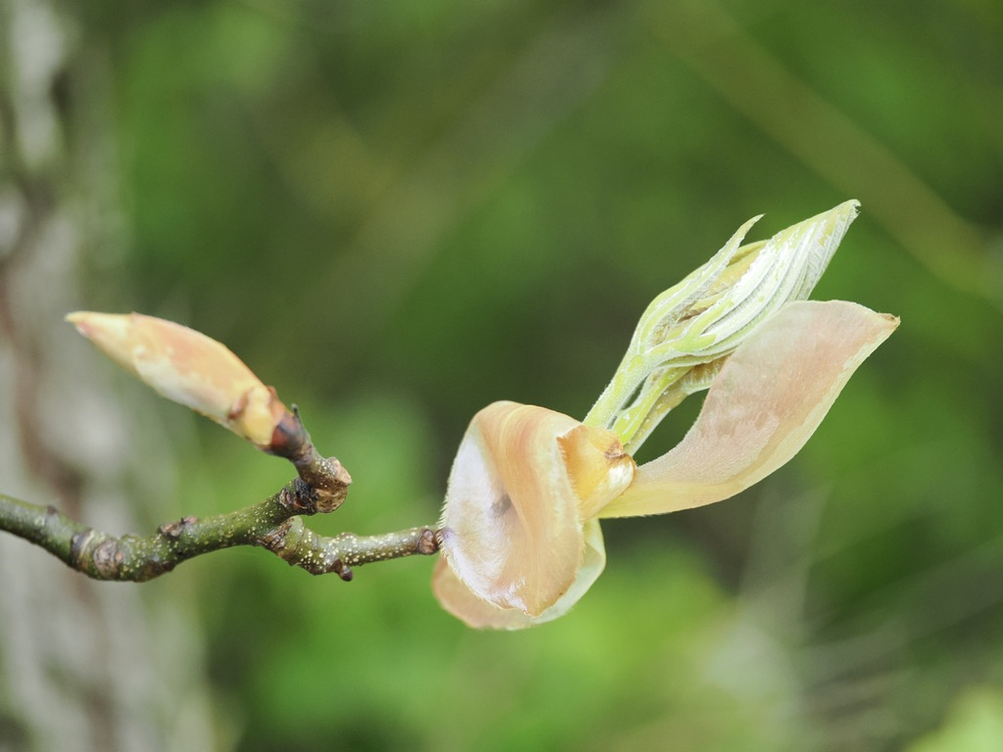
Notes:
Shagbark Hickory in the Botanic Garden. I love the textures and pastel colors.

Slide 25
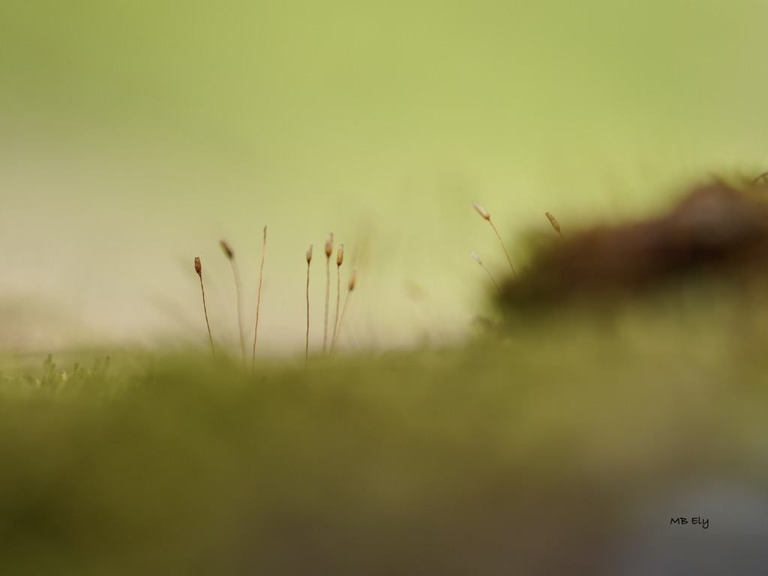
Notes:
More mosses – I call this one Soldiers at Dawn.

Slide 26
and look for hidden beauty
Notes:
Over time, I started seeing things that I hadn’t seen before – and the camera helped with that. Abstract shapes and textures, mysterious colors, reflections. People began asking me if these were really photos. Or were they paintings? Lots of surprising images.

Slide 27
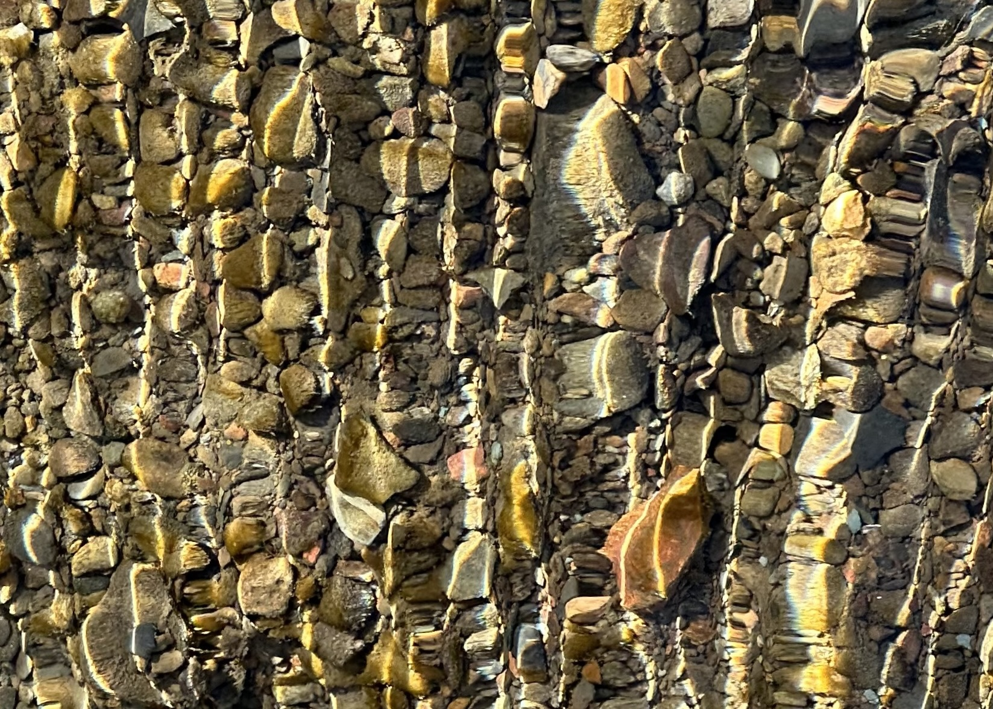
Notes:
A close up of Mingo Creek – blown up. I love this photo – an example of what the camera can see, can take in that I couldn’t really see with my own eyes.

Slide 28
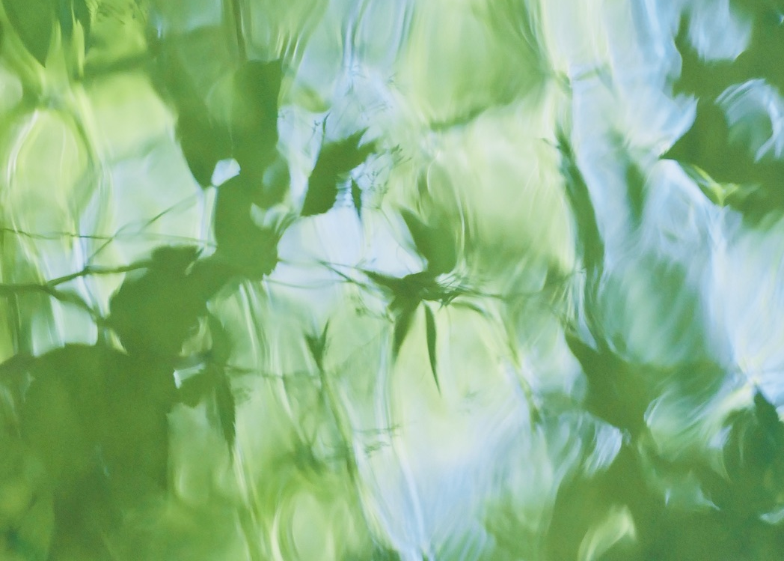
Notes:
A reflection of trees in Mingo Creek. It was a sunny summer day, June 2024. For this photo, I adjusted the exposure, but the colors are otherwise true.

Slide 29
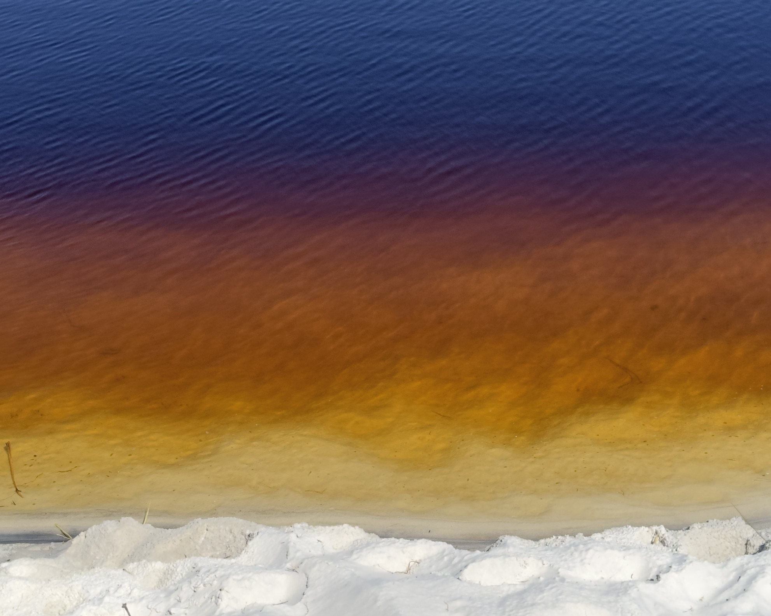
Notes:
Every year my sisters and I take a trip to the Florida panhandle. This is a photo of a coastal dune lake in Grayton Beach – the colors are real, untouched – this is a lake that shares its waters with the Gulf of Mexico – sometimes it is very much freshwater, other times it has lots of salt in it. It fascinates me and reminds me of how much I don’t know and don’t understand about how our Earth works.

Slide 30
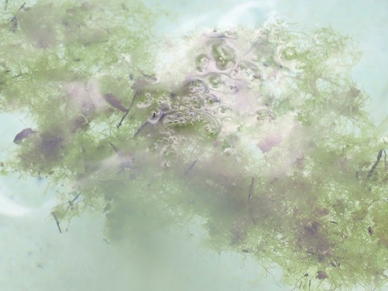
Notes:
An underwater photo in Morrison Springs Park in Florida. I was standing in the water, shoulder depth, with the camera about waist height, pointing up at the water surface from below.

Slide 31
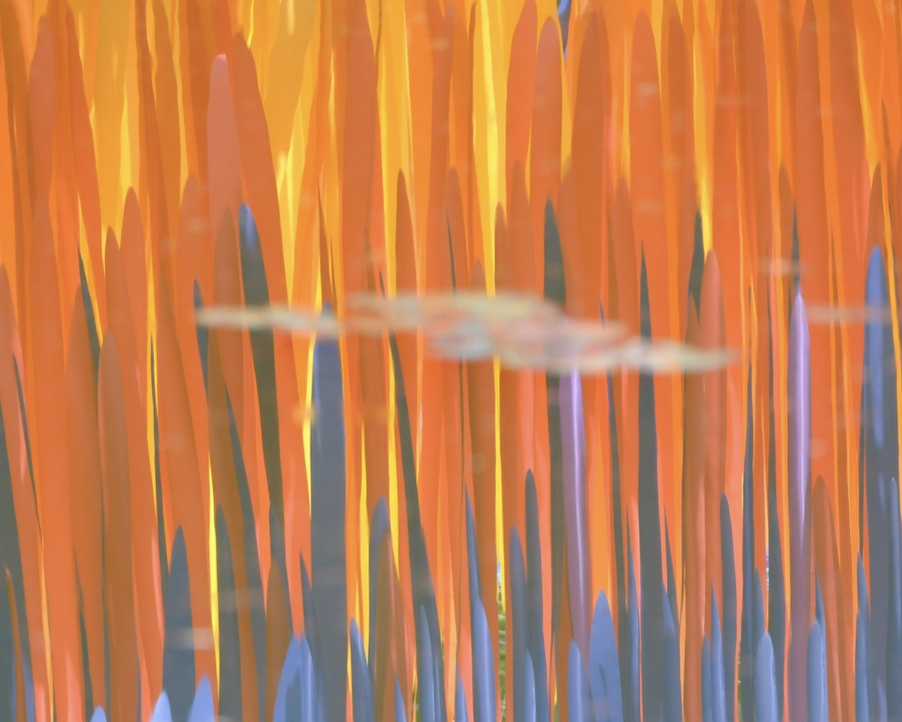
Notes:
You know where this one is! This is a reflection of last year’s art installation at the Botanic Gardens.

Slide 32
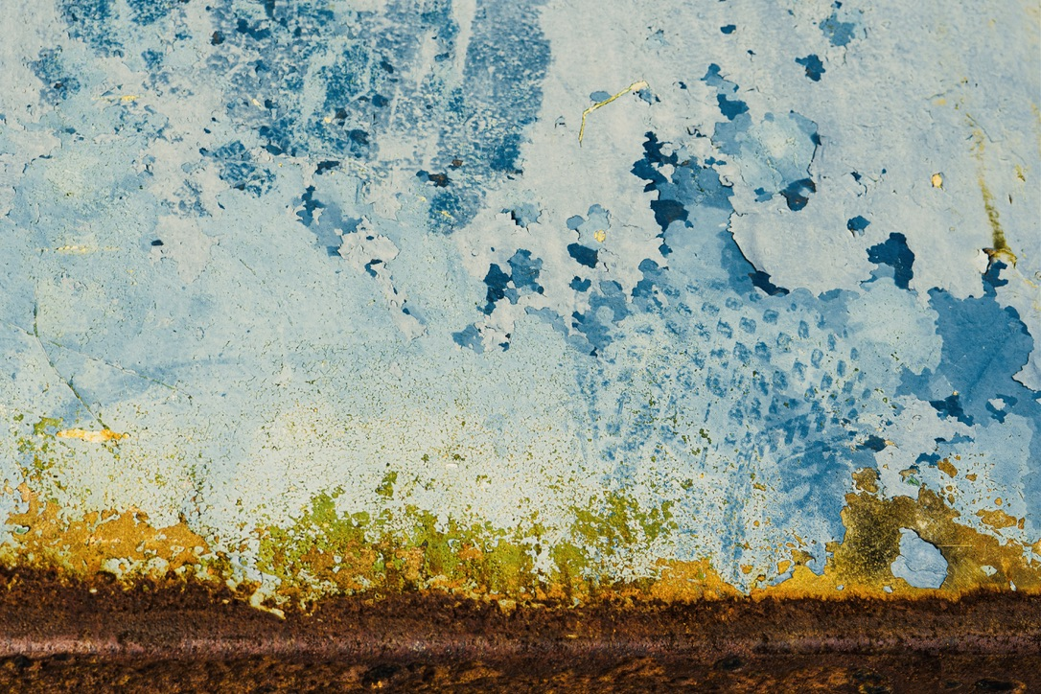
Notes:
And this – it is corrosion on a grill at Mingo Creek! I loved the colors and textures.

Slide 33
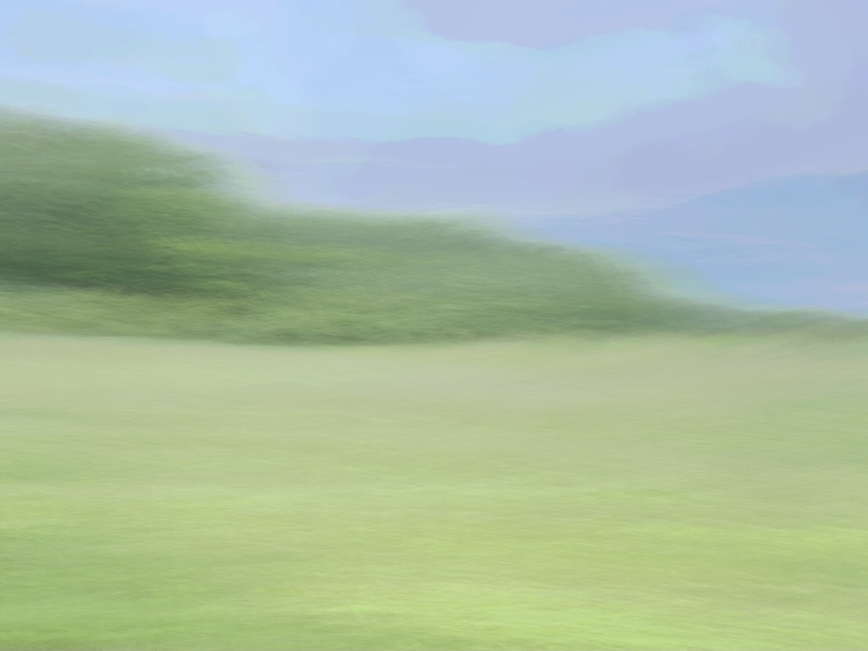
Notes:
This last photo was taken at the Botanic Garden with a process called Intentional Camera Movement – ICM.
To close out the nature photography discussion – I have found over time that, when I walk or swim out into nature, I feel like I am entering a world where I am just an incidental being – this world, the ecosystem, is a community that exists with or without human presence and goes on and on and on – living and dying and rebirthing.
We know now, from recent research from scientists like Susan Simard, the beings in forests and other ecosystems are in constant communication, sharing food and resources and information. All without human intervention. More and more often, when I am out there, I feel like I am a guest being welcomed, held by other forms of life. It is not just about me, what I get from the time I spend in nature. That is so reassuring and comforting for me.

Slide 34
ABSTRACT PAINTING
Alcohol Delaminating Ink and Acrylic Ink
Acrylic Paint
Liquid Watercolor
Notes:
The nature photography has gotten me, and still gets me, through hard times.
But in the last year or so, I felt like I needed a different way of expressing what I was feeling as I watched our social and political world implode. I felt sad, and scared, and angry. My nature photography helped but there was more that I felt I needed to somehow express.

Slide 35
paint what you cannot say
Notes:
I began to have dreams about colors, flowing colors. One day I saw something about painting with Delaminating Alcohol Ink on Instagram – it looked like such a fascinating organic process, so I began to explore through abstract painting.
Abstract painting with alcohol, and later, acrylic inks and paints, and liquid watercolors has taken me to new places – I never know what I am going to do, or where I will end up. Sometimes the paintings, especially with the inks, seem to take on a life of their own. These mediums, usually done in a very small format, have allowed me to express thoughts and feelings that I couldn’t easily put into words.
If I had to put a label on the predominant painting style or genre, I think I might I would use “abstract expressionism” – most of the paintings rise from intense internal emotions; there is a lot of energy and movement in many of the paintings. I paint with my fingers, a palette knife, a brush – or let the paints/inks move around on their own.
Most of my paintings still reflect the natural world to me in colors and shapes, but many go further to reflect my reactions to what is going on around me our social and political worlds. The paintings start with emotion, often confusing and heavy, and end up being whatever they were meant to be. The words, or titles, come later.

Slide 36
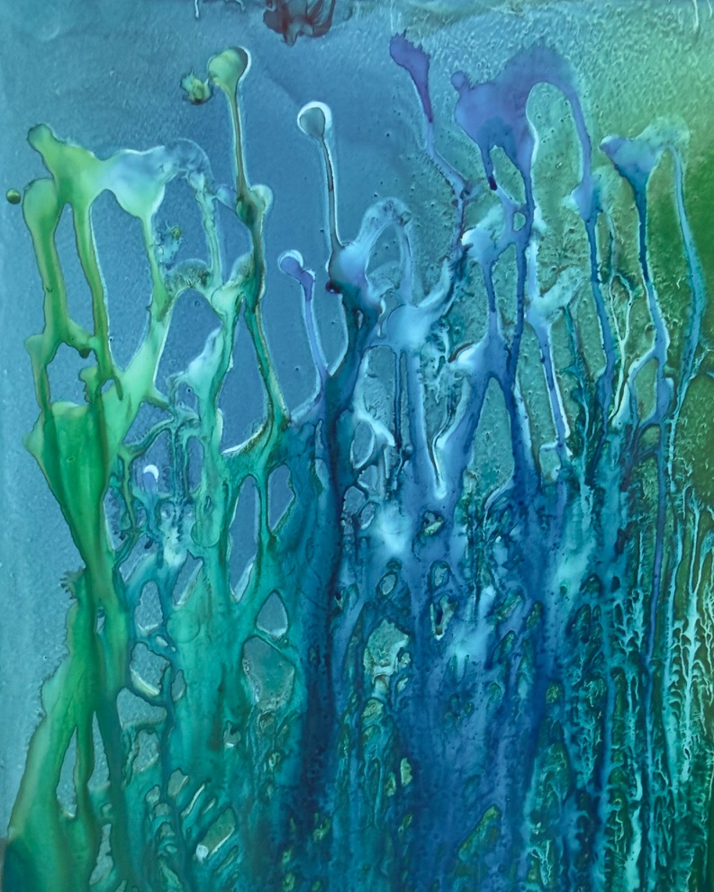
“where the current breathes”
Notes:
“Where the Current Breathes” – one of my first paintings
Delaminating alcohol ink – on non-porous paper

Slide 37
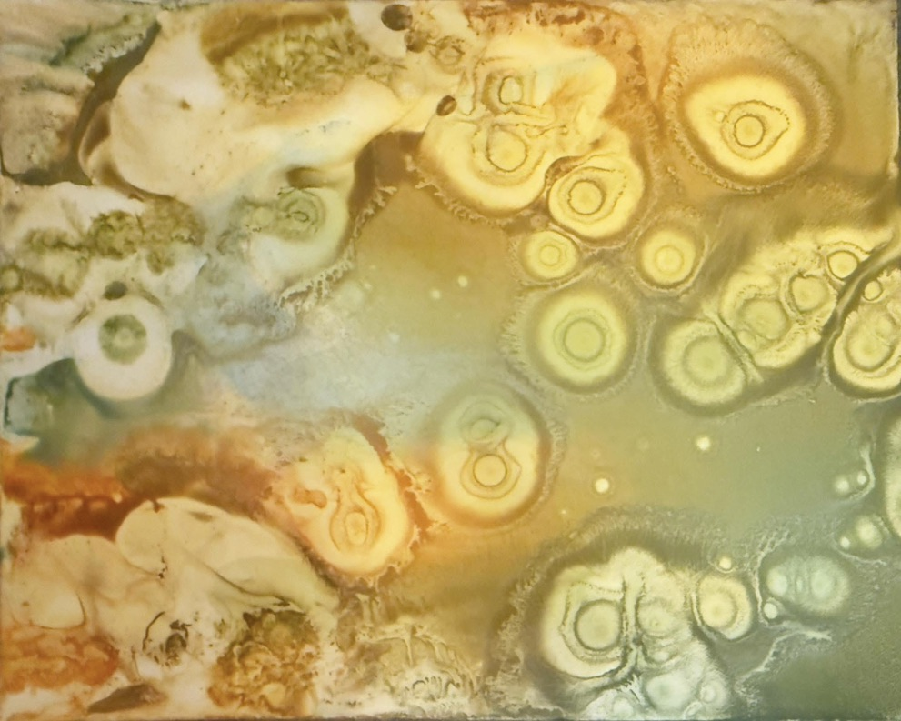
“from whence we come”
Notes:
“From Whence We Come” – another early painting. These felt amoeba- or protozoa- like to me
I painted this in my little art room at home, while my husband and his son were watching TV in another room.
After finishing this, I took a photo as I always do, then accidentally spilled alcohol on the painting – Larry and Cam heard me swear very loudly – “I screwed it up!”
They both yelled back at the same time – ”That’s all part of the process!”
So I added some more ink and alcohol to the painting and let it work and got this…

Slide 38
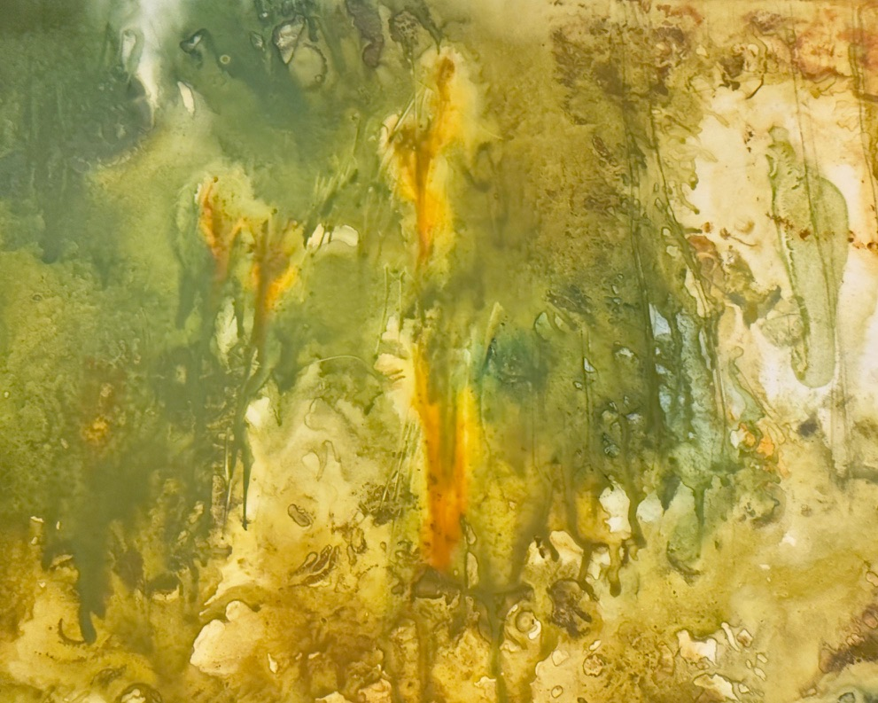
“autumn rain”
Notes:
“Autumn Rain”
As I am sure is the case with all of you – art is a constant learning process with failures and mistakes providing fuel for more interesting work

Slide 39
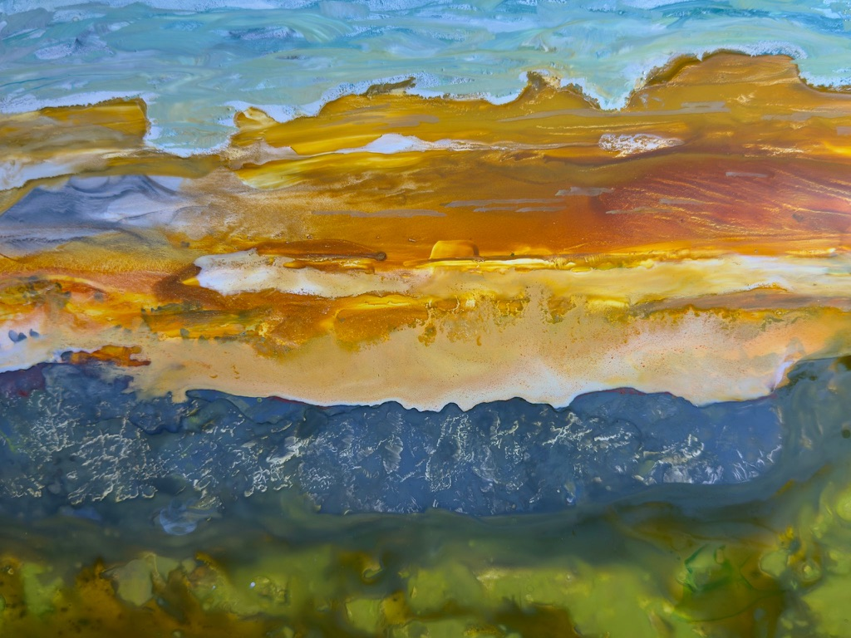
“breathe”
Notes:
“Breathe”
In 2025, Larry and I took a road trip across the country, ending up in Utah. The colors and textures and shapes, the expansiveness of the space, spoke to me and have stayed in my mind. This is an alcohol ink painting on non-porous paper using a color palette from out there.

Slide 40
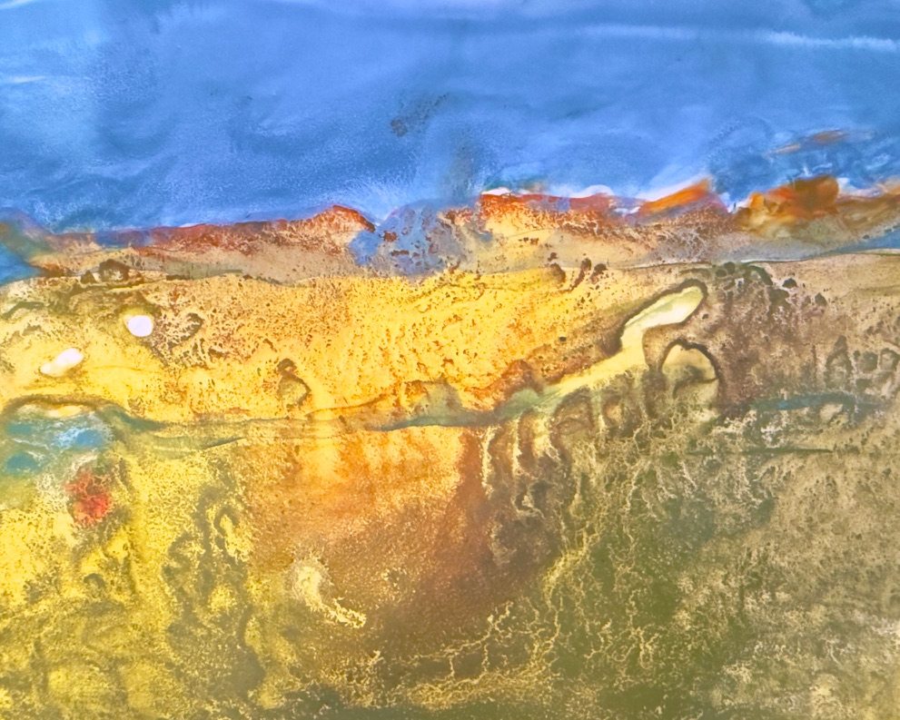
“life before humans”
Notes:
“Life before Humans”
Another Utah inspired painting – I see fossils? Skeletons?

Slide 41
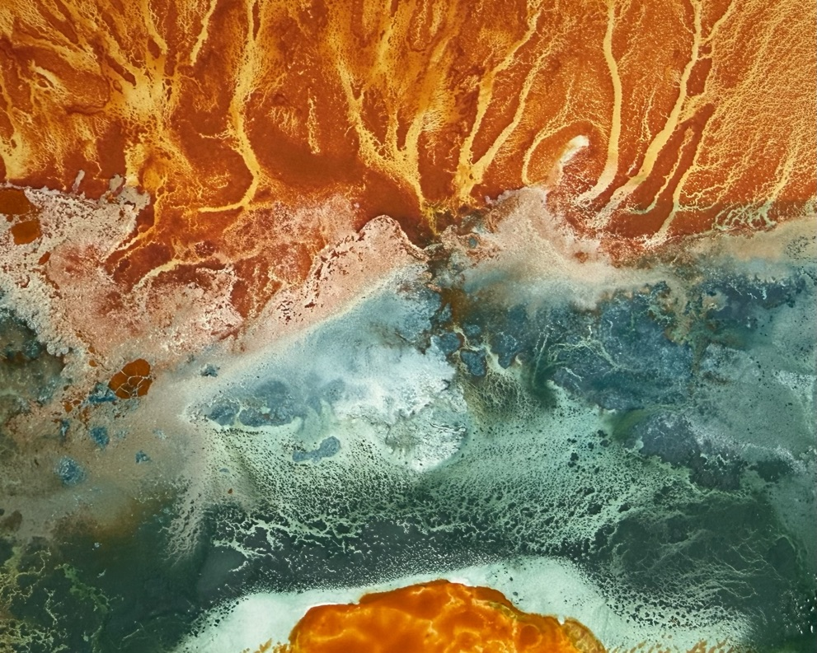
“upheaval”
Notes:
“Upheaval” – it was one of those days where I felt like the world was turning upside down

Slide 42
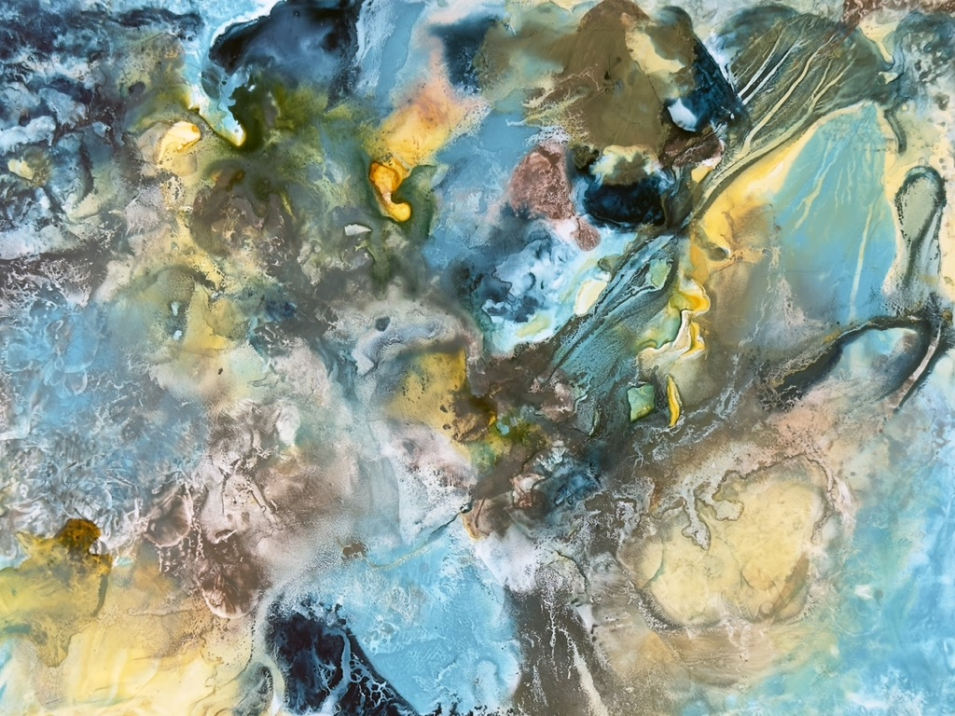
“beauty arises from chaos”
Notes:
“Beauty Arises from Chaos” – one of my favorites – just adding different colors of ink and watching them do their thing, and adding a little more color, moving it around with my fingers or letting it flow on its own. Alcohol ink on non-porous paper.

Slide 43
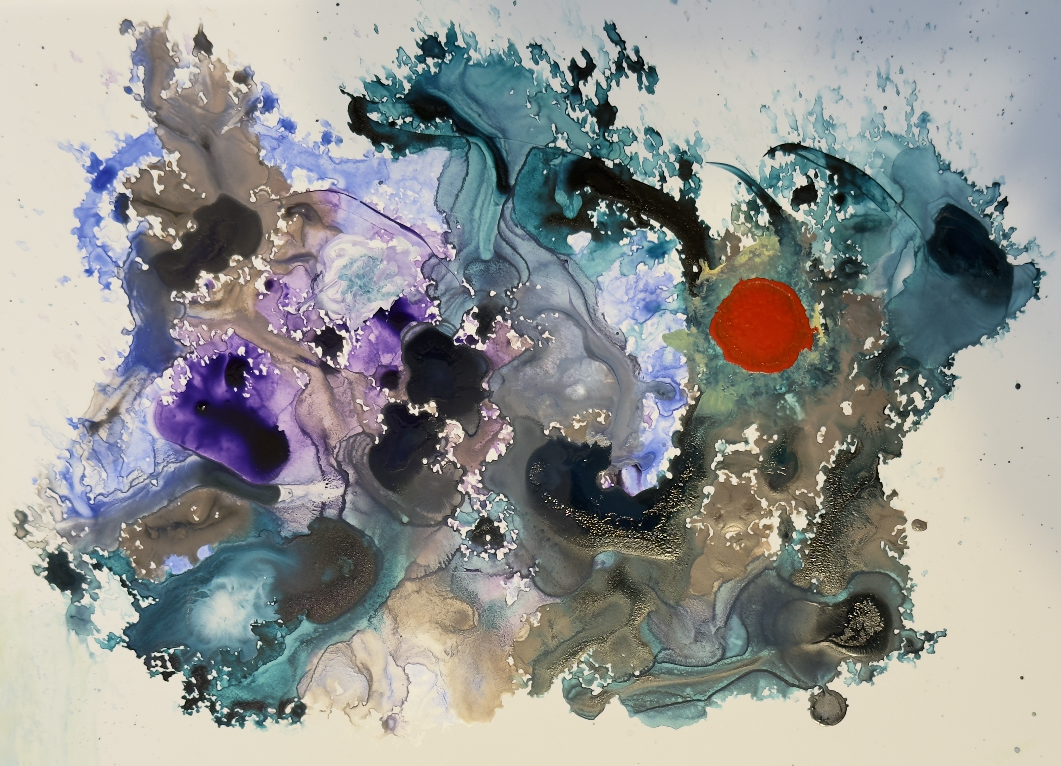
“focus”
Notes:
“Focus”

Slide 44
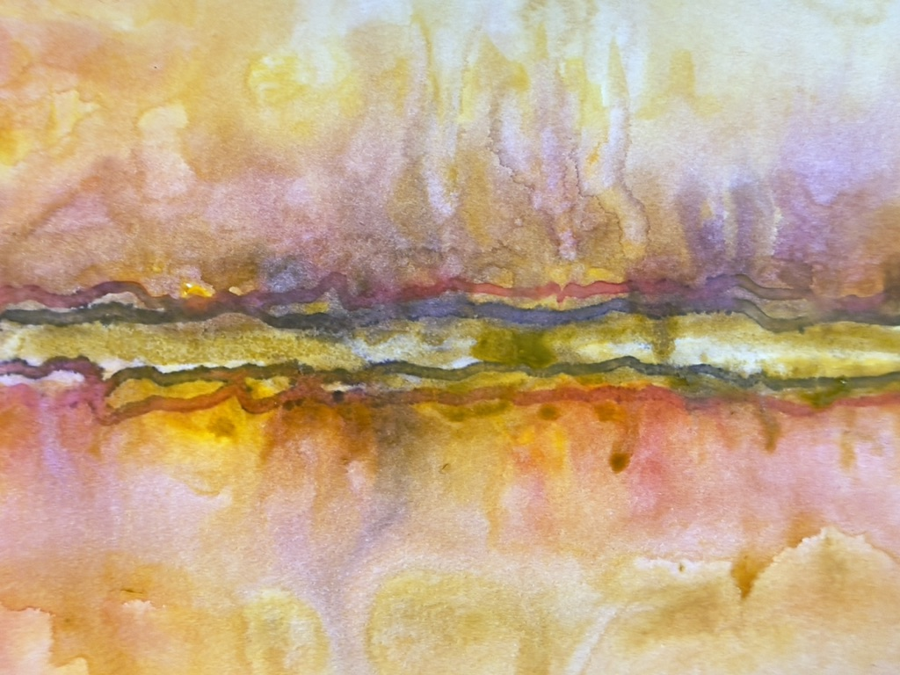
“between two worlds: now and what may come”
Notes:
“Between Two Worlds: Now and What May Come”
This is a process that involves liquid watercolors, acrylic inks, alcohol inks, and and a lot of water. This was on mineral paper.

Slide 45
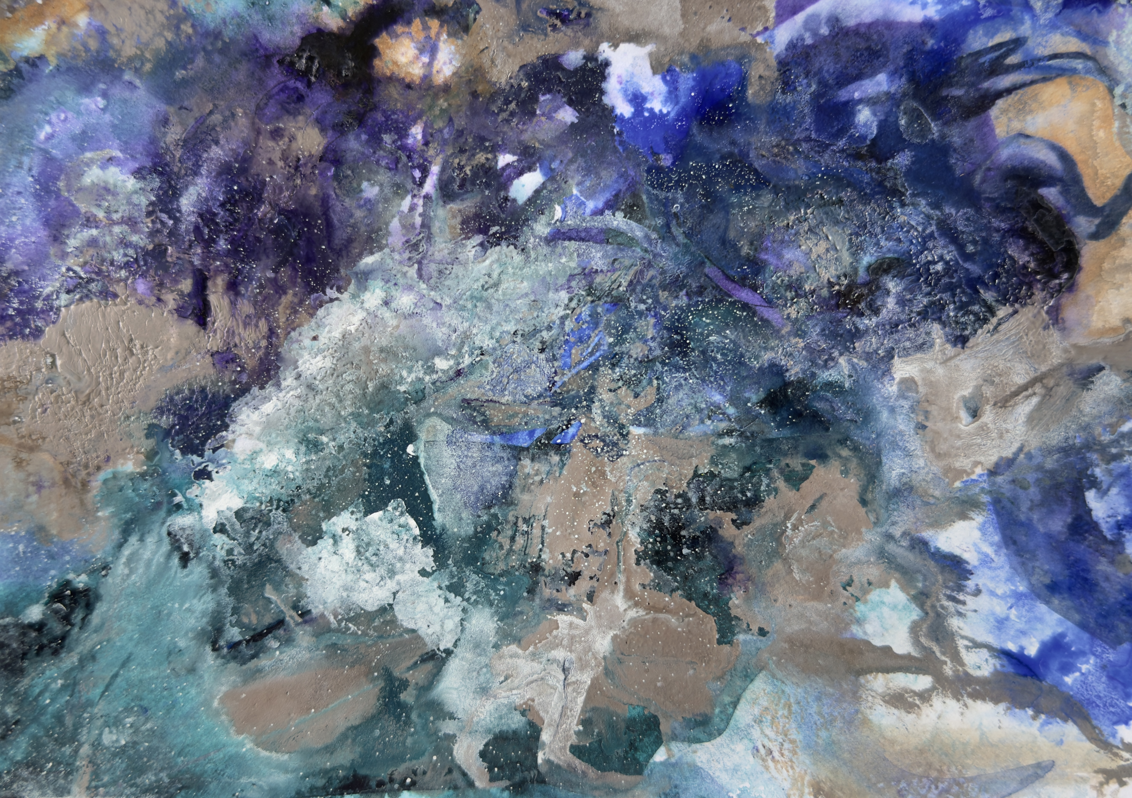
“strong voices rise together”
Notes:
“Strong Voices Rise Together”
Acrylic ink and alcohol ink on mixed media paper.

Slide 46
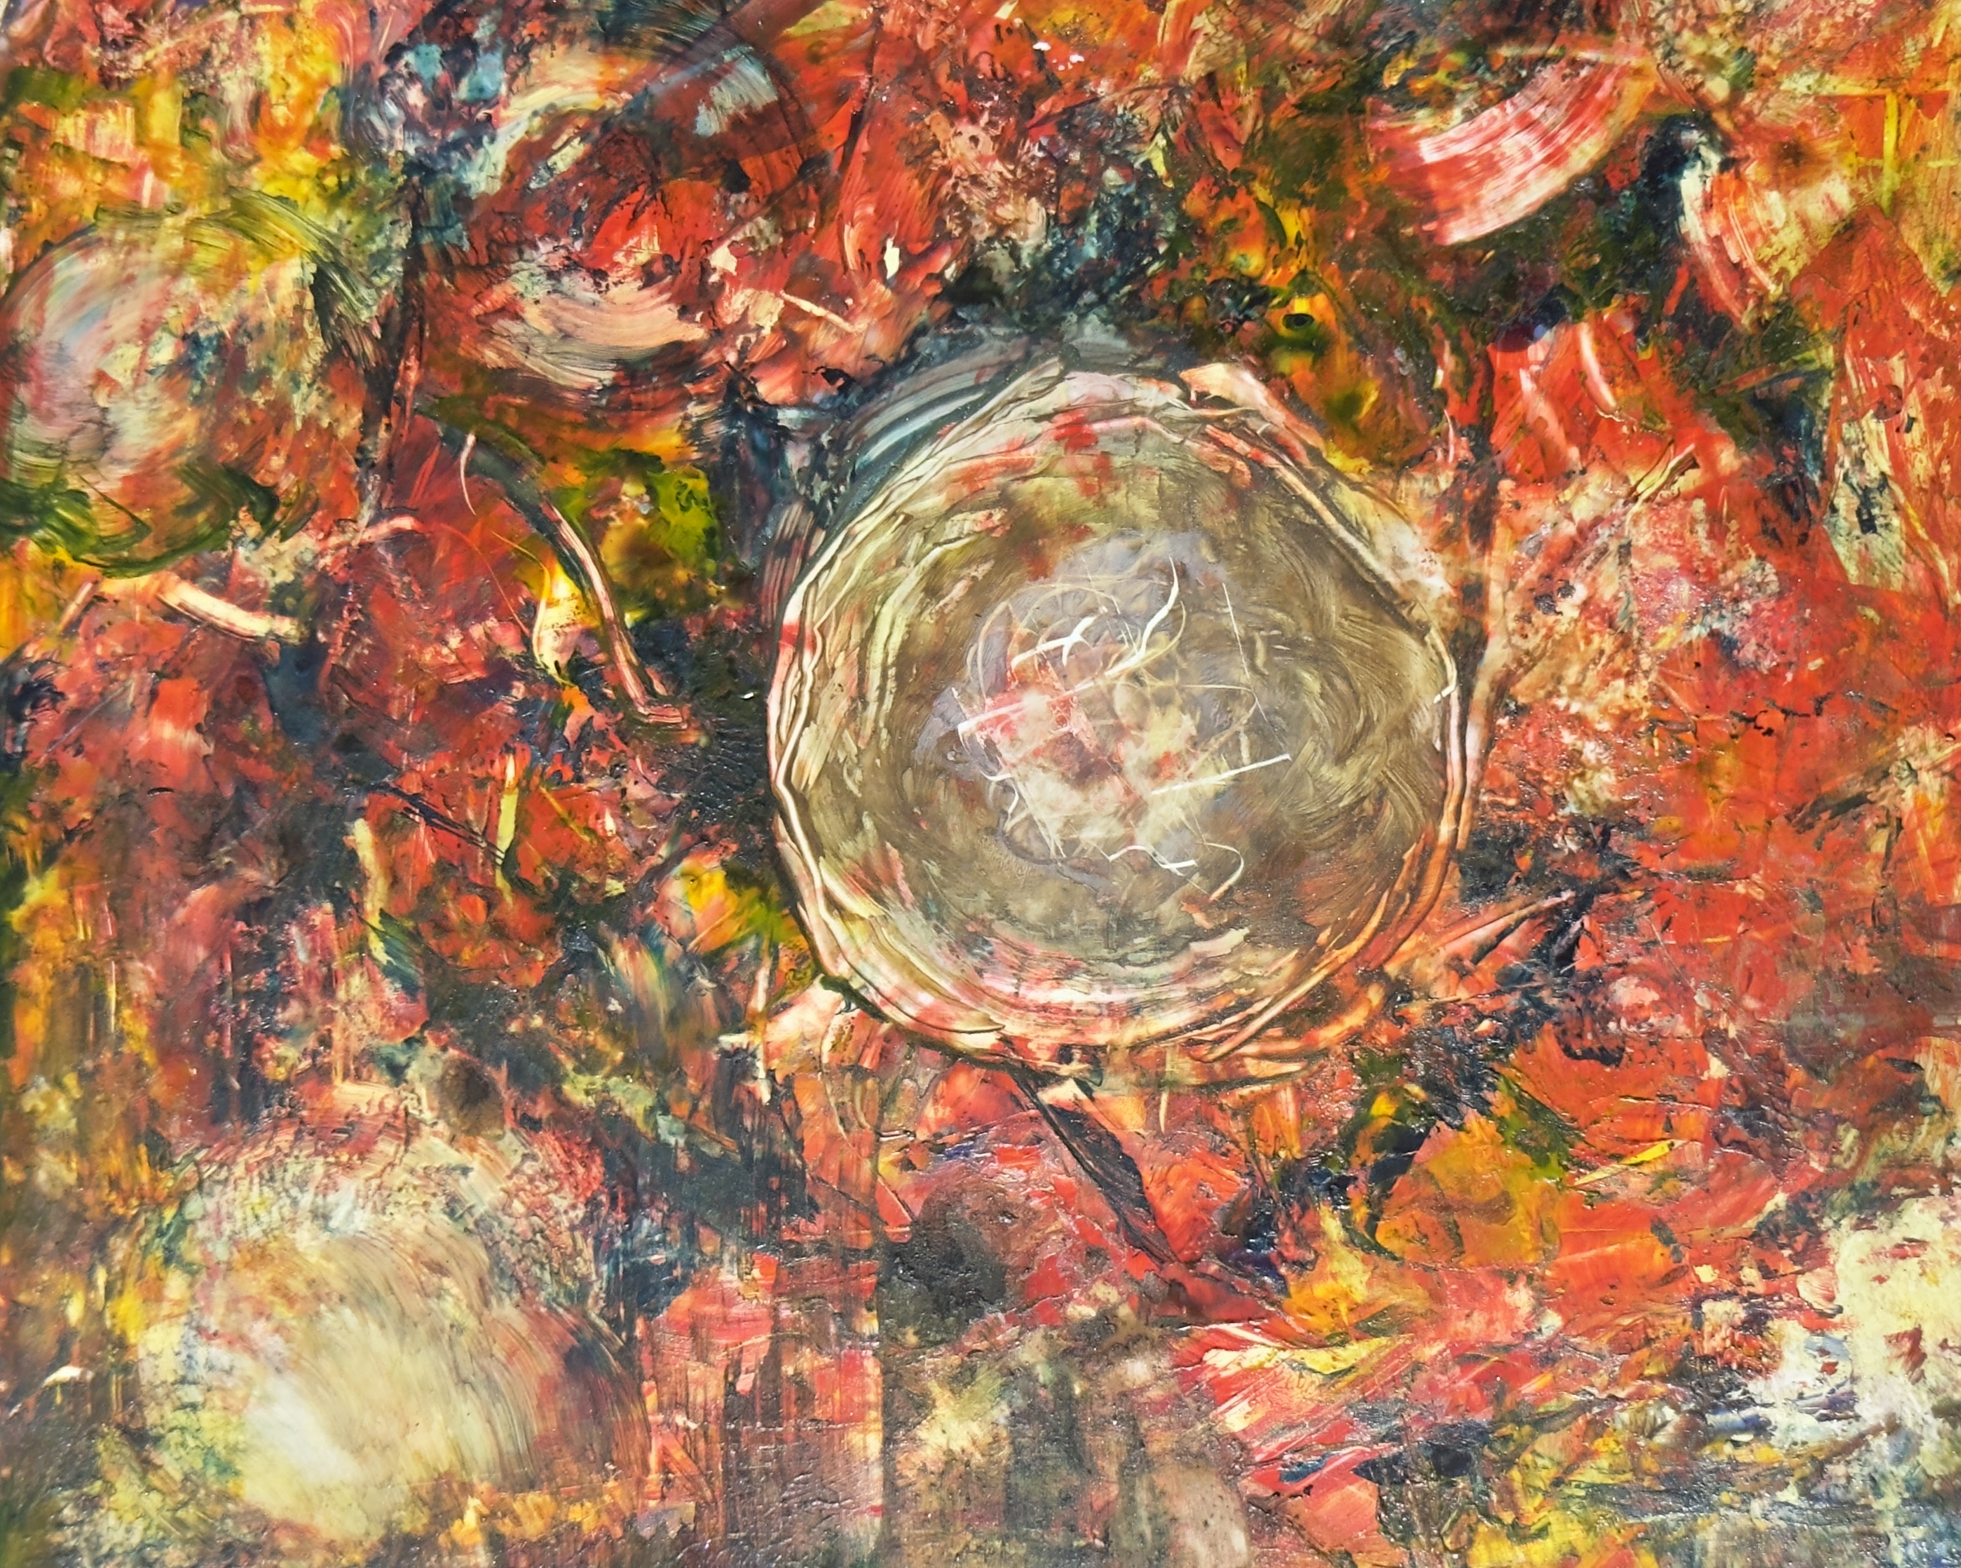
“new life from furious energy”
Notes:
“New Life from Furious Energy” – another one of those unbelievable news days.
This was one of my first acrylic only attempts – inks and paint – on paper.

Slide 47
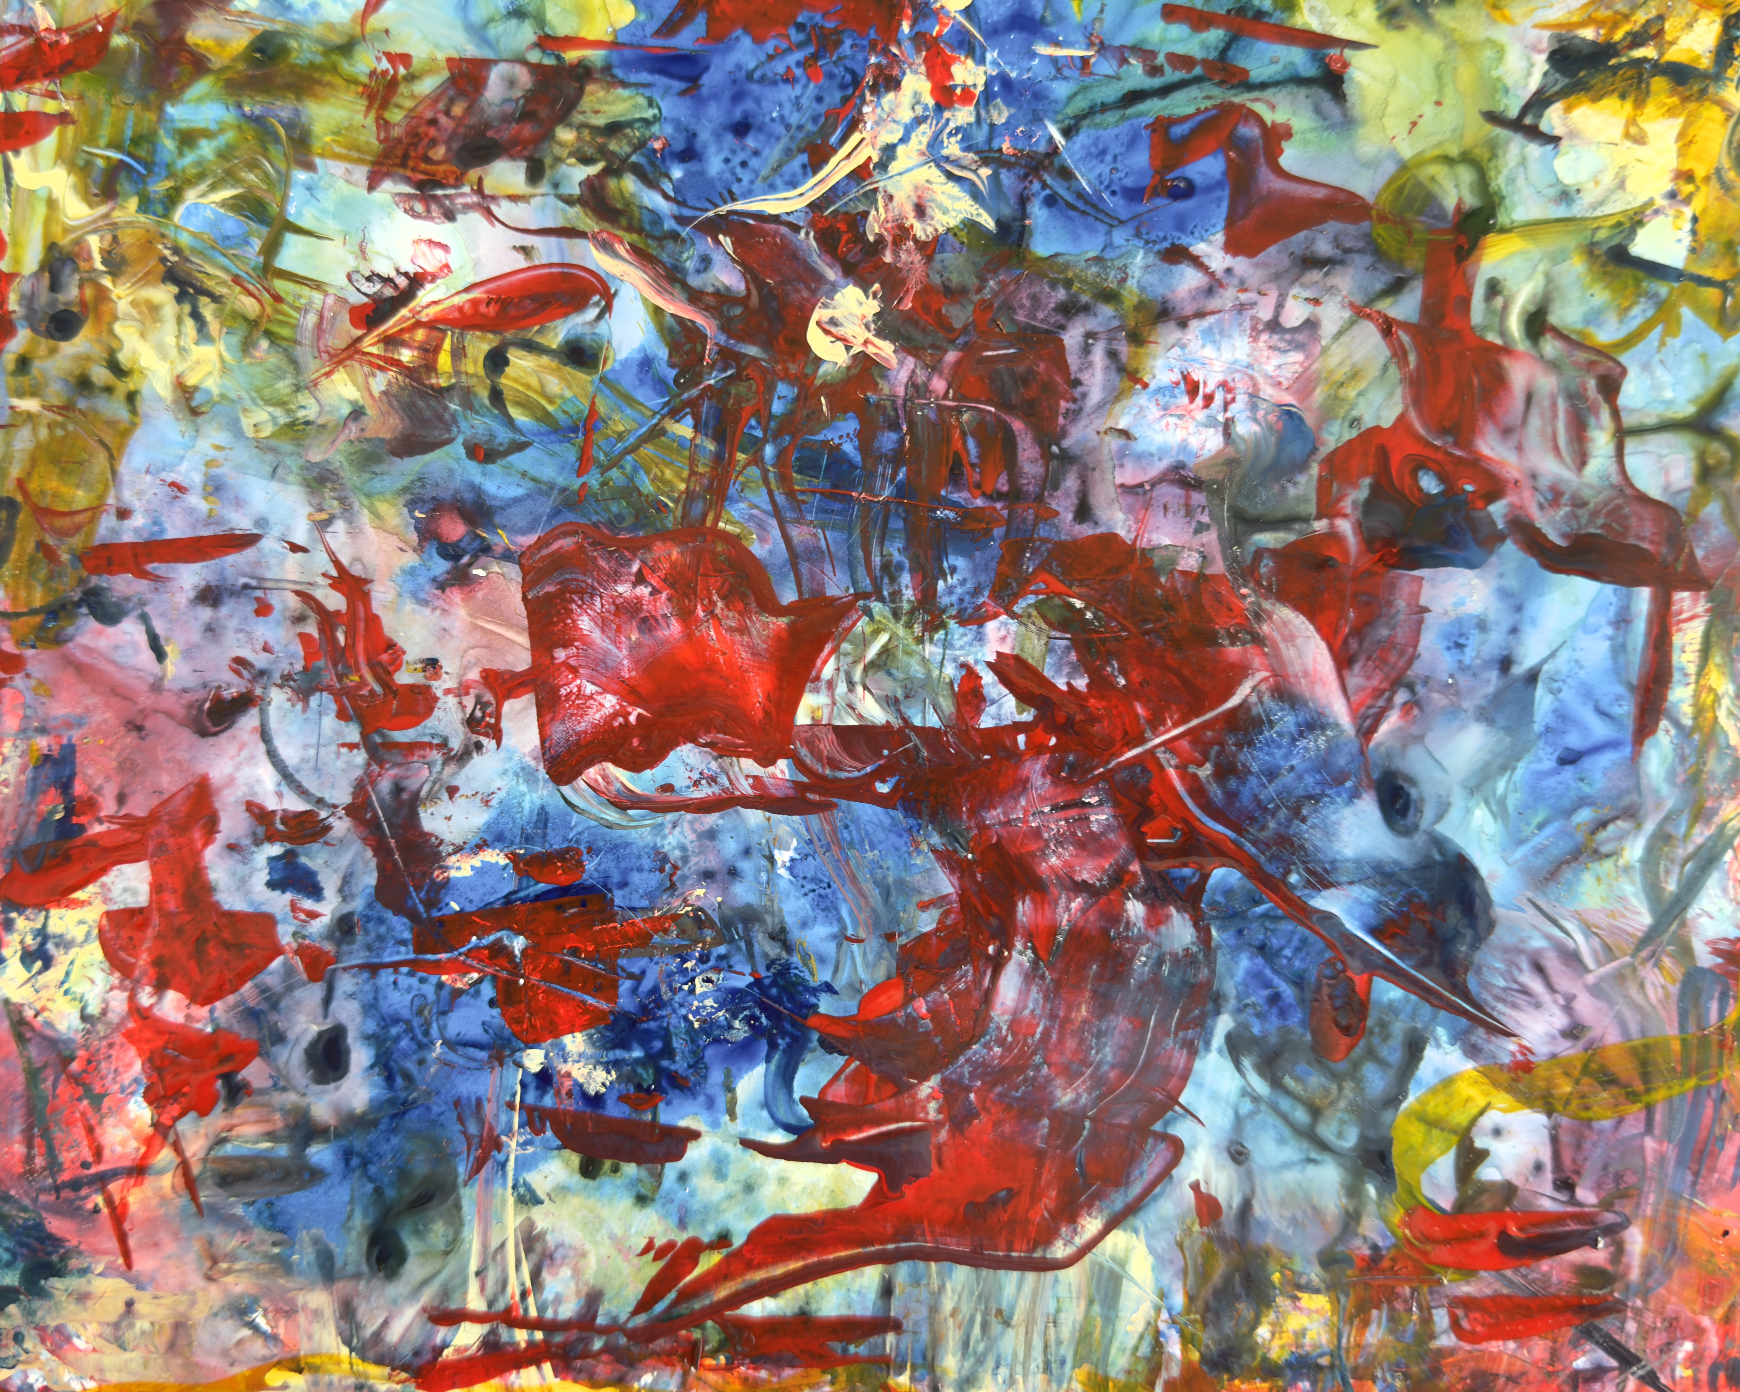
“wailing in rage”
Notes:
“Wailing in Rage” – another day that evoked strong emotions.
Acrylics on paper

Slide 48
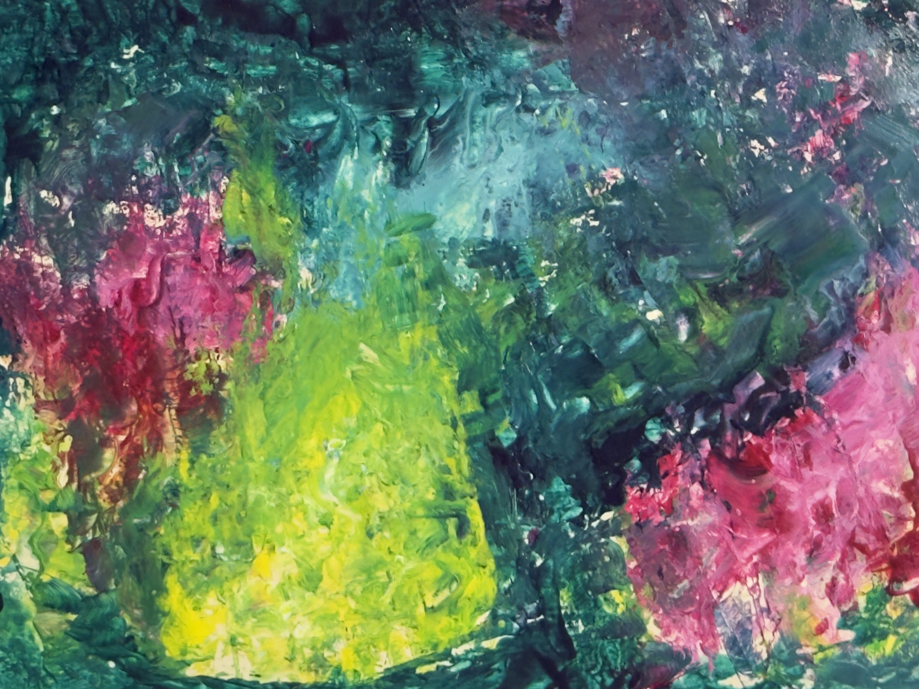
“south padre island 1”
Notes:
I took my paints with me on this year’s road trip through Texas. This was a painting that I did one night at twilight on our hotel balcony in South Padre Island. I THOUGHT I had made reservations at the South Padre National Seashore, where we would have seen lots of birds and turtles and other wildlife. But no. This was SPI – in the middle of SPRING BREAK!!!
I hadn’t painted at all on this trip and I needed to, if you know what I mean. It was twilight. Larry rigged up a tall lamp from the hotel room so that it shone onto the table on the balcony – it was almost dark but I persisted!

Slide 49
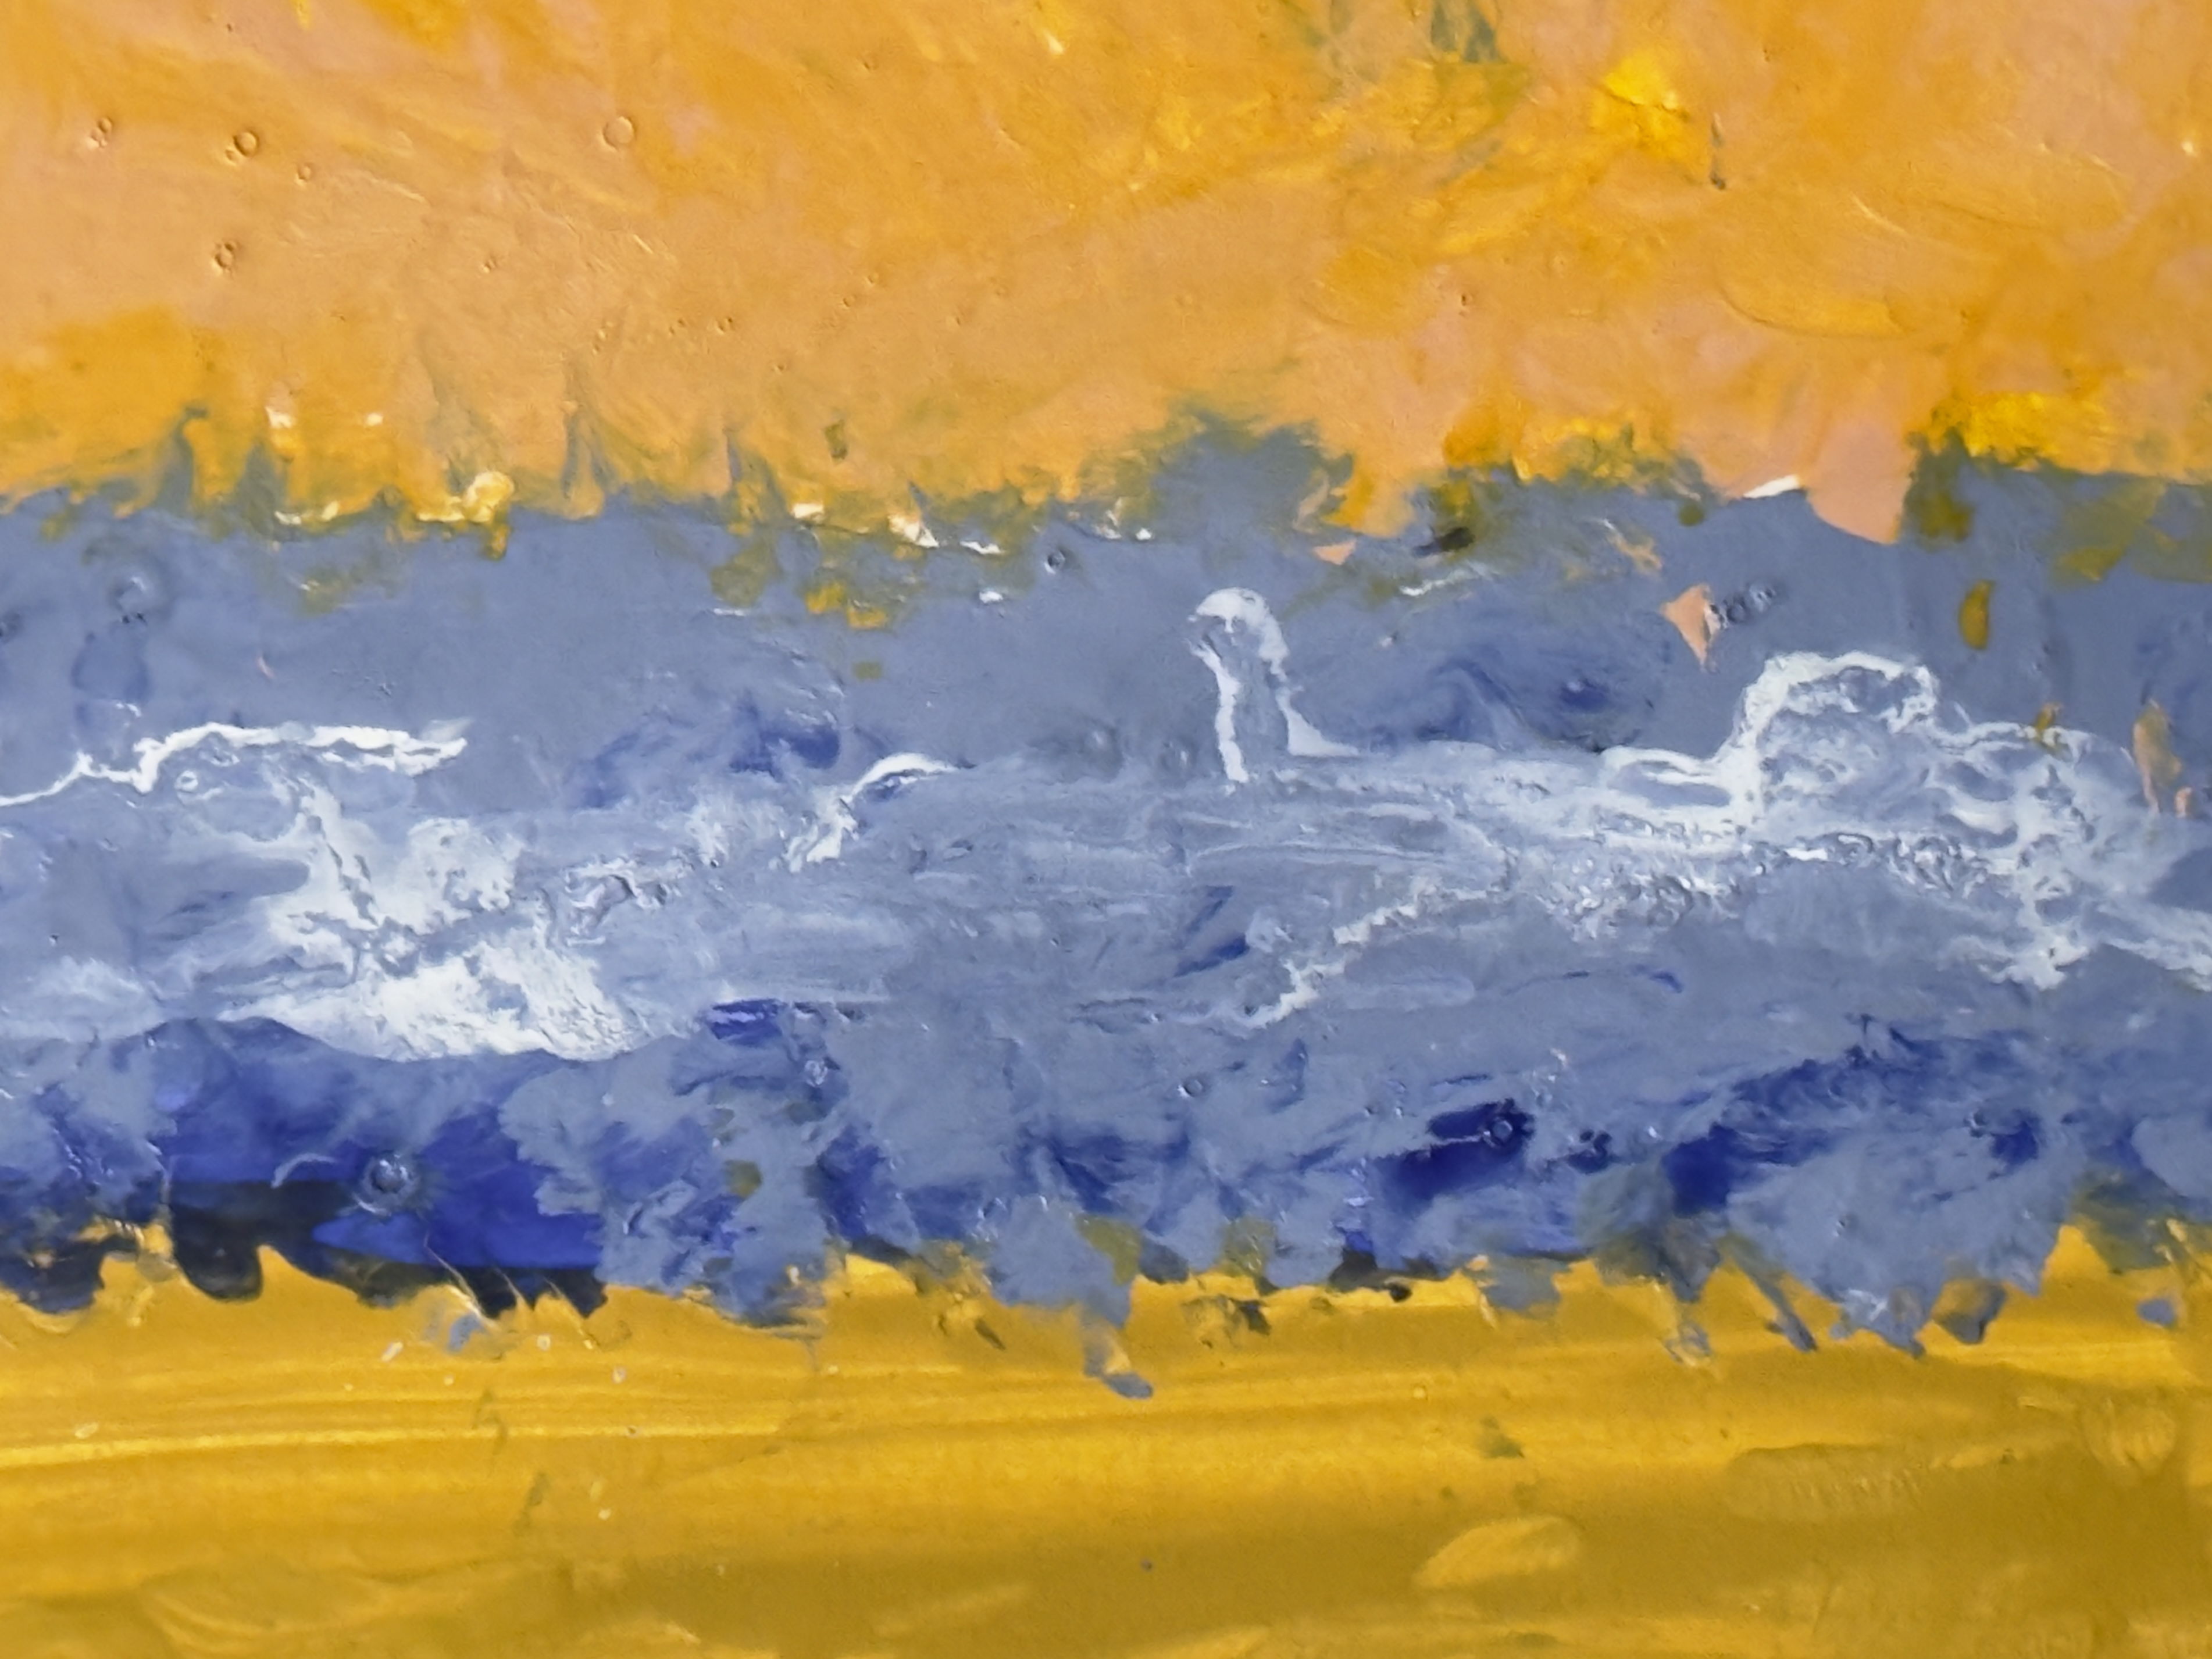
“south padre island 2”
Notes:
And this was my second effort from that night.

Slide 50
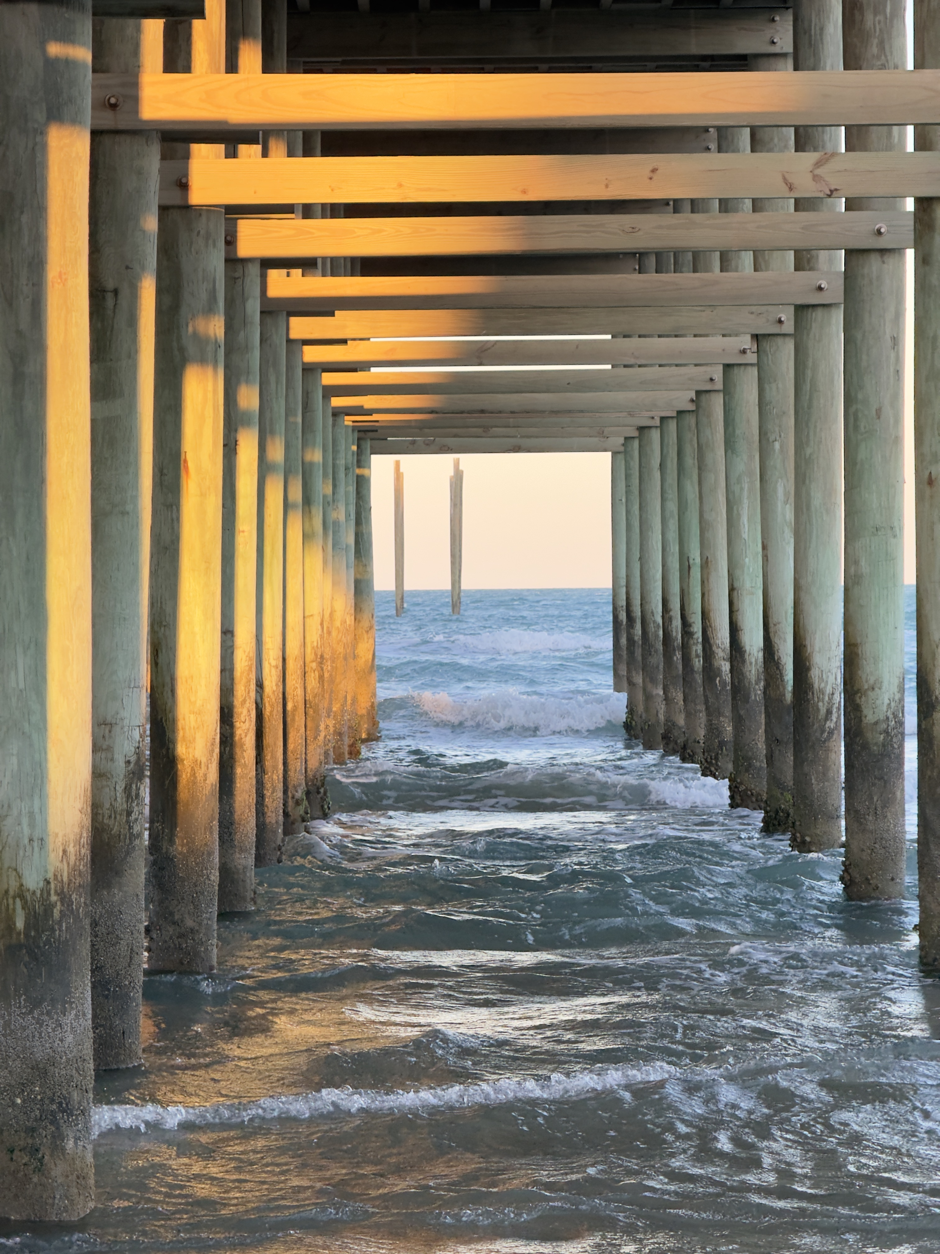
Notes:
I called this presentation – Love Letters to Nature. That stands. The connections I feel in nature, the gratitude and awe I feel when I take photos in the field, are always there. The paintings continue this theme – by being inspired by the natural world and by the inclusion of humans in that universe of nature – humans who do wonderful things and those who do awful things that lead to much sadness and grief.
So finally, a photo from SPI – you can’t see it but behind me are spring break revelers – AND it was also St. Patrick’s Day! But in front of me was this glorious scene that tells me – there is so much ahead in the future – and we don’t know what that might be, in our own lives, our artwork, or in the larger world. In spite of the violence and ignorance that I am witnessing in the larger world everyday, I am also witnessing goodness and integrity and strength, and I choose to believe that what is ahead may be quite beautiful.
QUESTIONS?
AND QUESTIONS FOR YOU:
What has inspired you in your art making?
What role, if any, does creating and making art play in your lives when you are dealing with either challenging or joyous times?
Have you (and I know many of you have!) found yourself moving between different mediums and art forms? What drives those shifts?

